Slide 1
Liquid Unit Calibration
With the tank empty, fill tank completely full (1600), document total gallons loaded
Set computer to apply product at 40 gallons per lane mile
Note: Start mileage when you start applying product
Apply product for 10 miles (keep speed consistent)
X = lane miles per gallon
X = (start gallons – gallons remaining)/miles

Slide 2
Liquid Unit Calibration
Refill tank, document # of gallons
Compare computer read out to the amount that was placed back into the tank (these amounts should match)
Make sure computer speed and speedometer match
If amounts are different, adjust computer according to the manufacture’s manual under the calibration chapter

Slide 3
Trouble Shooting
Things to Check Prior To Changing Computer Settings
Is Pump Working
Plugged Nozzles
Electrical Connections
Hydraulic Connections/Level/Leaks
Valves Set In Spray Position
Filters Plugged
Is Flow Meter Working
If Truck is Equipped With Radar Make Sure it is Clean
Air connections

Slide 4
Before you adjust anything, make sure you check with the mechanic or a Supervisor

Slide 5
Materials
Sand salt mixtures
Mag Chloride
Cold Temperature modified mag chloride
NC3000
Ice Slicer
Ice Buster
Mag treated sand
Designer salt

Slide 6
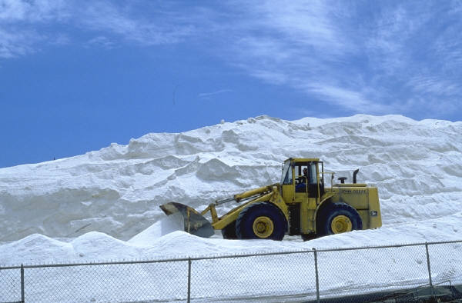
Notes:
This is a mountain of salt at a salt mine

Slide 7
Sand/Salt Mixes
Pros
  Most common product used
  Provides traction
  Works well in all type of weather and storm events
  Initial Cost
Cons
  Bad for the environment
  Causes additional work for maintenance crews
  Water and Air Quality
  Broken Windshields
  Cost of Clean-up
  Bicycle Safety

Slide 8
Pre-Wetted Sand
PRO’S
  Adheres to roadway.
  Chances of refreeze less than other products.
  Works from top down.
  Keeps snow pack from bonding.
  Cost Savings, reduces sand and liquid usage.
  Desired product in snow areas, where colder temperatures exist.
CON’S
  Additional storage and Containment
  Mixing of product is time consuming.
  Can plug sanders.
  Depending on what type of liquid deicer used to pre-treat sand, can leach out of sand.

Slide 9
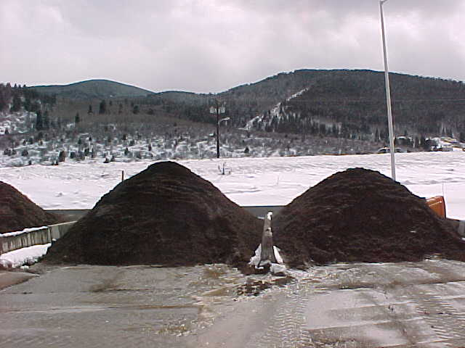
Pre-Wetted Sand
Two piles for tests
One pile, 8 gals caliber 2000 with one ton of sand
Second pile 10 gallons caliber 2000 with one ton of sand

Slide 10
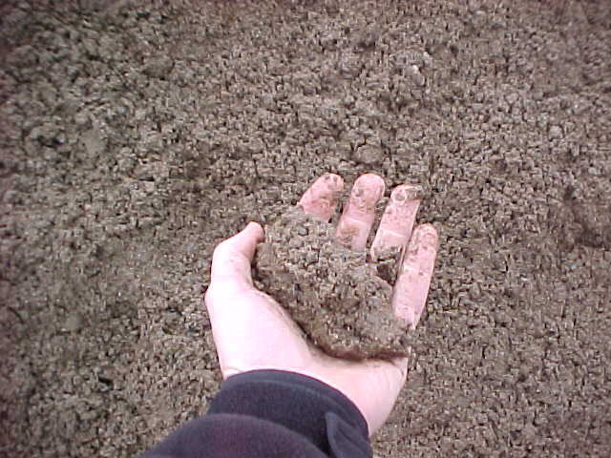
Caliber -2000
Pre-Wetted Sand
8 - Gallons Caliber 2000 per ton of Sand
Sand Balls up in Hand
Unable to Squeeze any Product from Sand
8 Gallons Maximum is Recommended (Due to plugging grates and sanders)

Slide 11
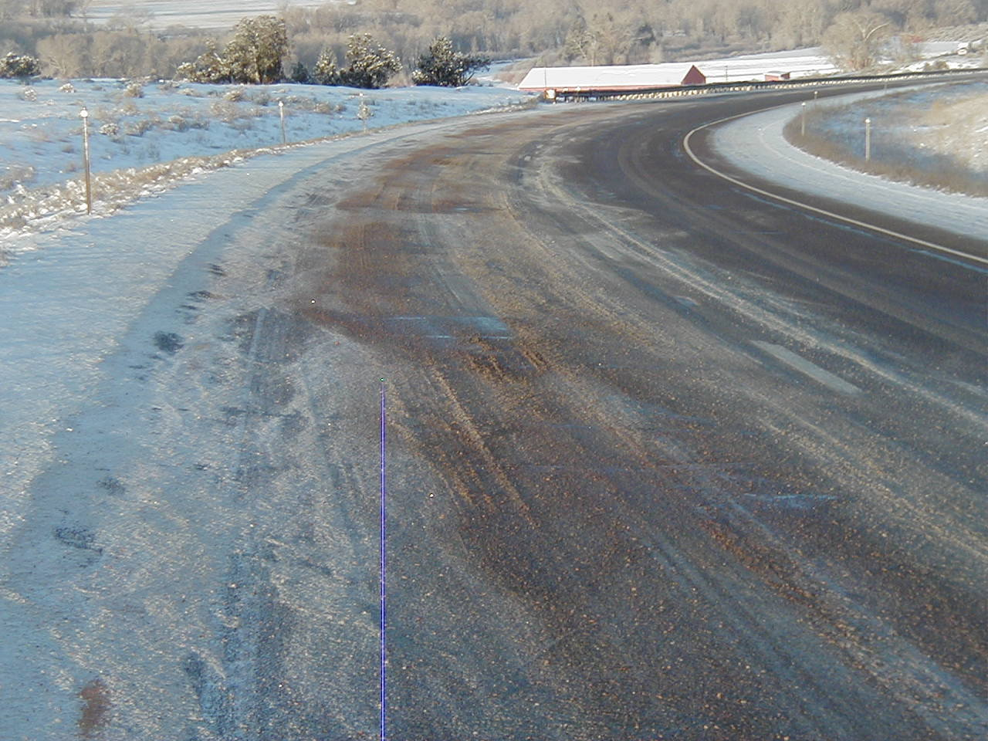
Caliber 2000 – Pre-Wetted Sand
Caliber 2000
8 gallons per ton of sand
500 lbs. per lane mile
Reduces sand usage
More effective than salt/sand mixes

Slide 12
Caliber 2000 – Pre-Wetted Sand
Caliber 2000
8 gallons per ton of sand
500 lbs. per lane mile
Reduces sand usage
More effective than salt/sand mixes

Slide 13
Reducing the Loss to Bounce and Scatter
Slow Down and don’t sand bare roads!
Traditional Dry Application
Pre-wet Salt Application
Pre-wetting allows you to reduce the amount of material applied per lane mile and still get the same amount where you want it. The solid deicer also becomes more effective.
Don’t apply liquids on the shoulders.
5%
90%
5%
20%
60%
20%
5%
Critical Area
Critical Area

Slide 15
Ice-Slicer
PRO’S
  Excellent melting capabilities
  Excellent results when applied to snow pack
  Melts from the bottom up
  Reduces Amount of Product used in heavy snow fall areas
CON’S
  Can refreeze.
  Storage and Containment
  Can cause icing during initial melting stages.
  If Over applied, increased costs (Sanders need to be calibrated)

Slide 16
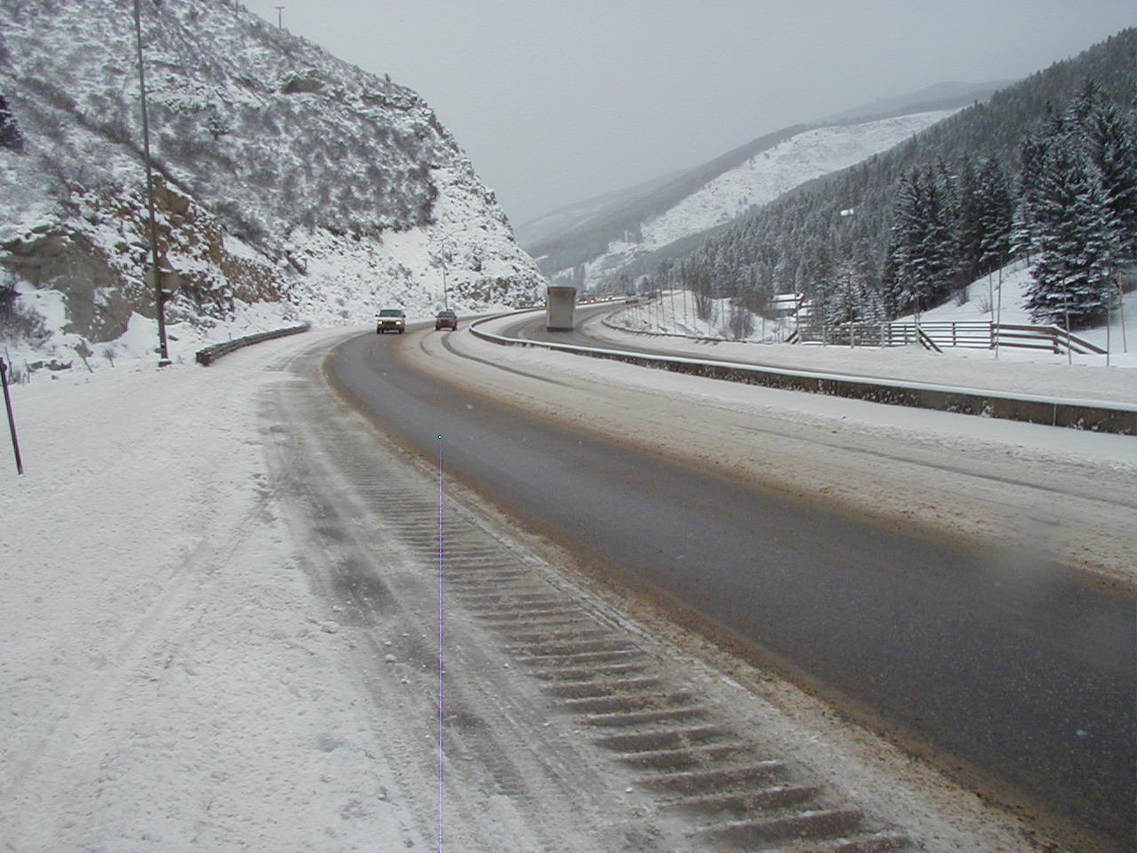
Ice Slicer
300 lbs. Per Lane Mile

Slide 17
Ice Slicer / Sand Mix
PRO’s
  Fast melting with additional traction,
  Chances of refreeze not as severe.
  Can be used as anti-icing and de-icing applications.
  Good application for heavy snow fall areas
CON’s
  Storage and Containment
  Mixing of Products
  Expensive product if over applied. (Sanders Need to be Calibrated)

Slide 18
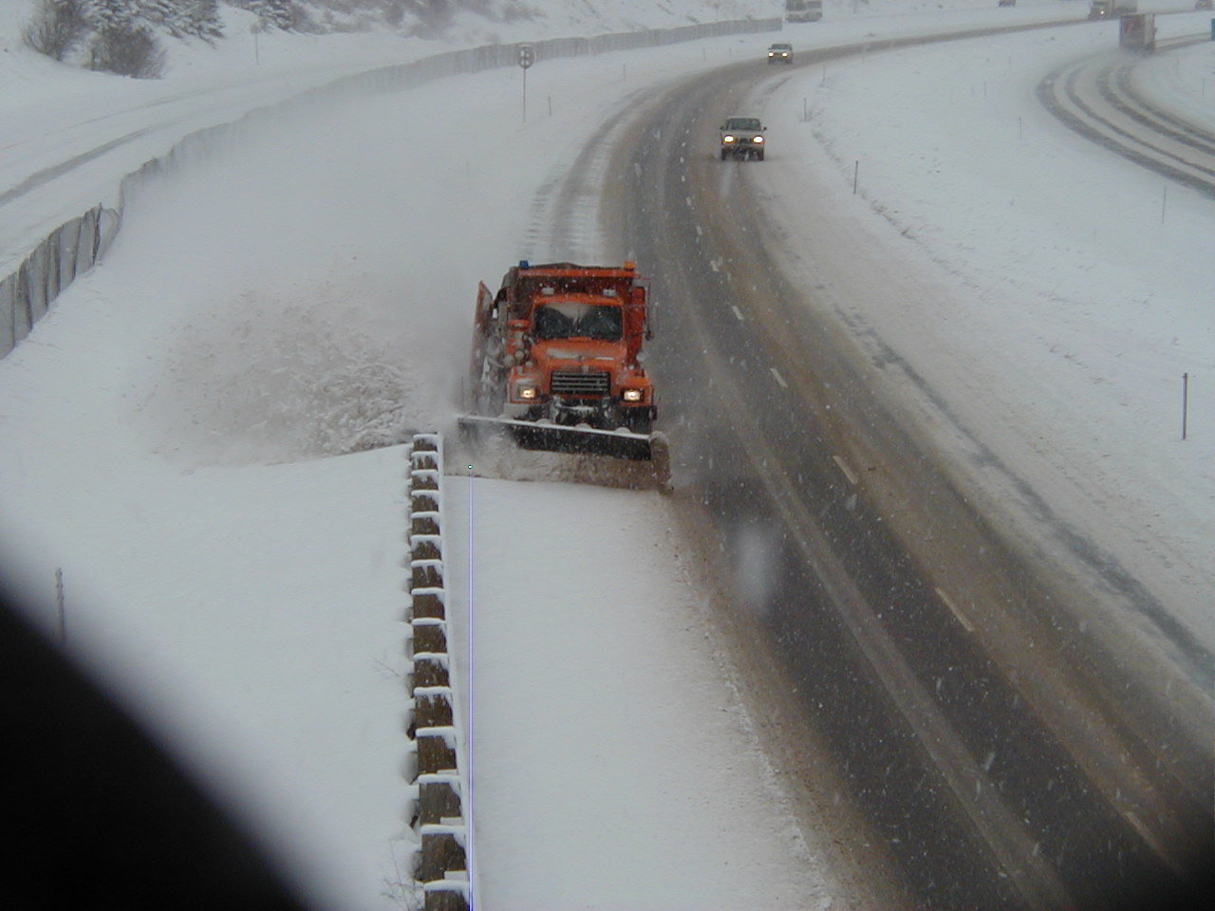
Ice Slicer/Sand Mix
350 lbs. per lane mile
4 inches of snow
22 degrees ambient temperature
25 degree surface temperature
Results - right lane remained wet

Slide 19
Liquid Program
Overview, goals and strategies
Materials
Tool box
Application rates
Safe loading and unloading of products
Response to spills
Calibration
Clean equipment
Notes:
All spills must be reported to your supervisor.

Slide 20
Mag-Chloride
PRO’S
  Can be utilized for ant-icing and de-icing applications.
  Reduces Sand.
  Reduces Accidents.
  Reduces Sand Clean up by Maintenance Personal.
  Improved Levels of Service
  Reduces Personal and Public Property Damage
CON’S
  Use care during heavy precipitation and cold temperatures.
  Use care on snow pack.
  Public concerns.
  Increased material costs.
  Avoid using before crack pouring operations.
  May increase Vehicle Problems
  Increases Traffic Speed
  Perception of Pre-wetting

