Slide 1
Calibration
Notes:
The most important aspect of using alternative de-icers.

Slide 2
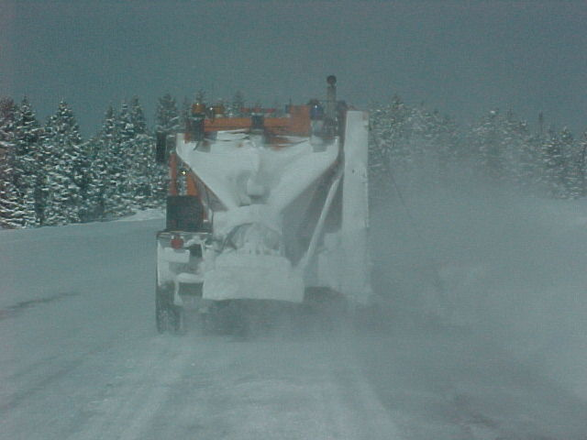
How much product are you applying?
Notes:
If you are not calibrated, you don’t know how much you are putting out. If this is the case, you may be wasting materials and costing us more money, creating a hazard with dilution of solution or damaging the environment.

Slide 3
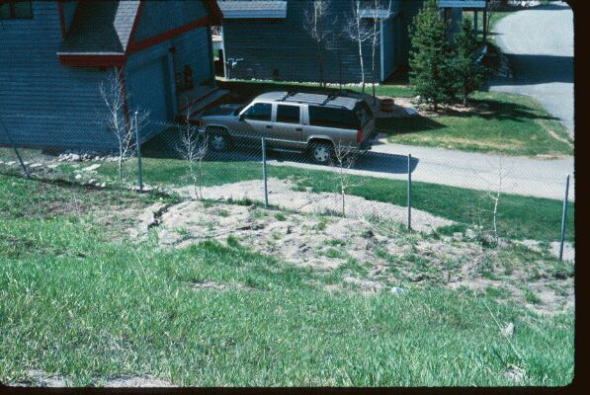
This is not beach front property
Notes:
This is sedimentation of sand from I-70 onto private property.

Slide 4
Enough sand?
Notes:
Too much sand? No accidents or car parts
What becomes of the sand now? What about it getting cast into the store fronts and vehicles by traffic? Have you ever tried to stop on sand?

Slide 5
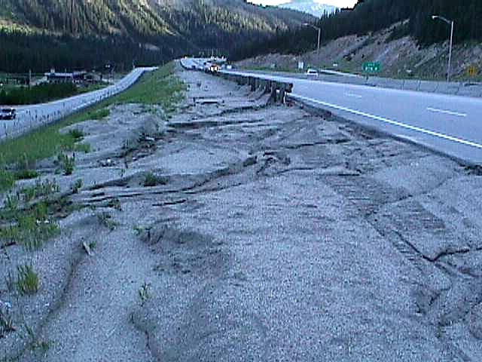
What are your objectives?
Our objective for these locations is to reduce the amount of sand being used.
Notes:
Top picture is Glenwood Canyon, look at the sand on the other side of the jersey wall.
The bottom picture is I-70 East of Eisenhower tunnel.

Slide 6
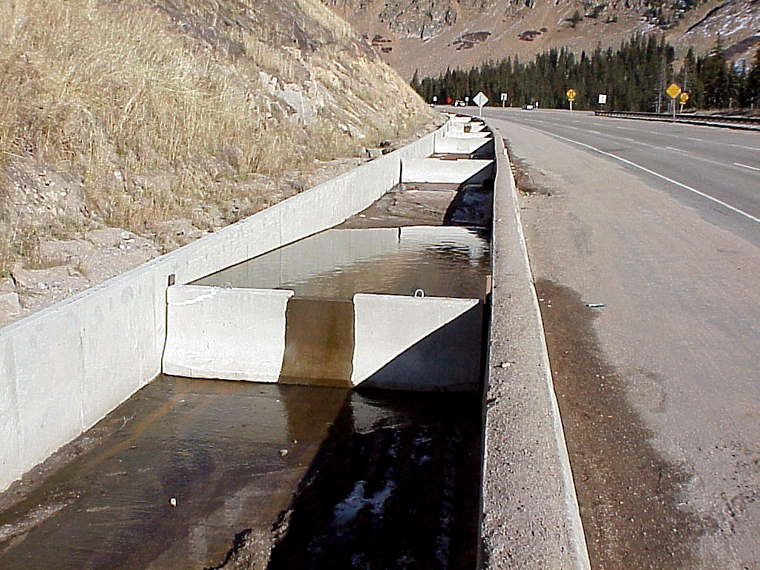
Notes:
West of Eisenhower tunnel. This was designed and built by Paul Dejulio. It allows sand to settle out of the snow as it melts.

Slide 7
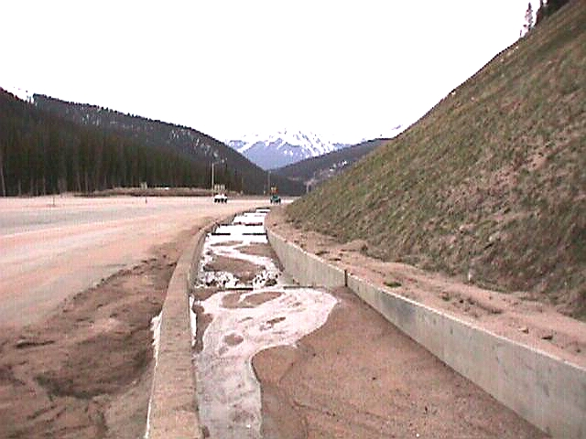
After One Season
Notes:
Sand is collected and used for building sound berms on I-70

Slide 8
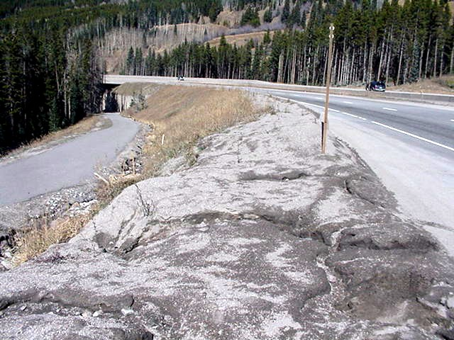
Notes:
Vail Pass next to bike/ped path

Slide 9
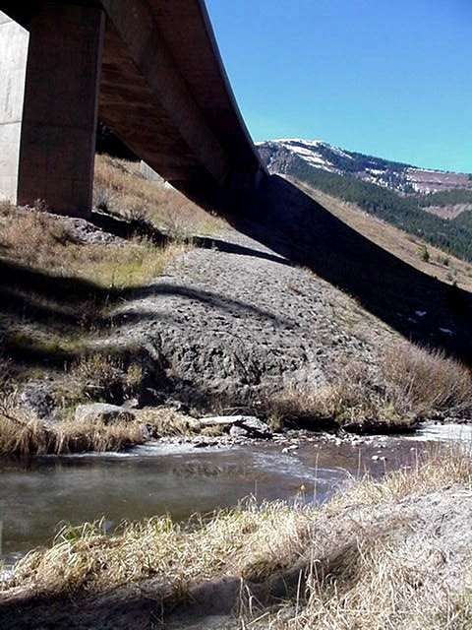
Notes:
Black Gore Creek under I-70

Slide 10
Calibration
How much Product is being applied per Lane Mile?
ALL Sand Trucks and Liquid Units must be Calibrated.
  Each unit must be calibrated for each product used
Do not Trust the Computer readouts in your Equipment.
Perform actual tests between Computer read outs and the amount of Product that is actually applied
Notes:
Our maximum on sand/salt is 500 lbs. per lane mile

Slide 11
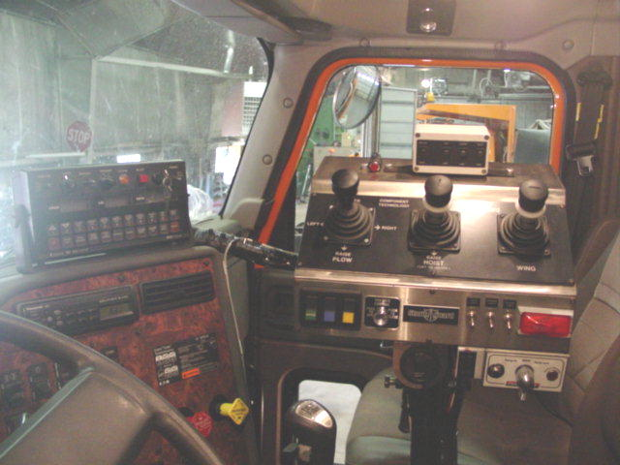
Notes:
There are a number of different types and manufacturers of computer controllers

Slide 12
Sander Calibration
Figure calibration at a 30 M.P.H.
  1800-2000 RPM’s
With the truck parked, run the belt for 2 minutes = one mile
Weigh the sand and adjust belt or gate accordingly
Set the flow rate so that (ex… 200 lbs. Is released in two minutes) 200 lbs. per lane mile is applied.
Notes:
There are a number of different methods and procedures to do this. Pick one that works for you and that is accurate.

Slide 13
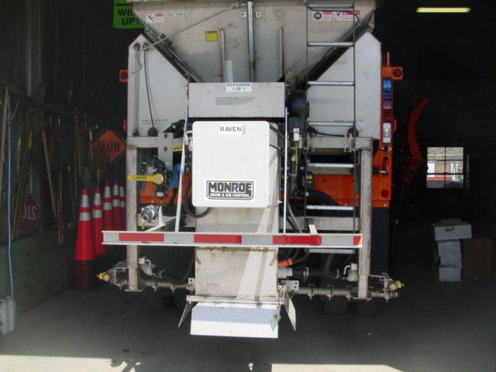
Notes:
This is what we are currently getting on state award

Slide 14
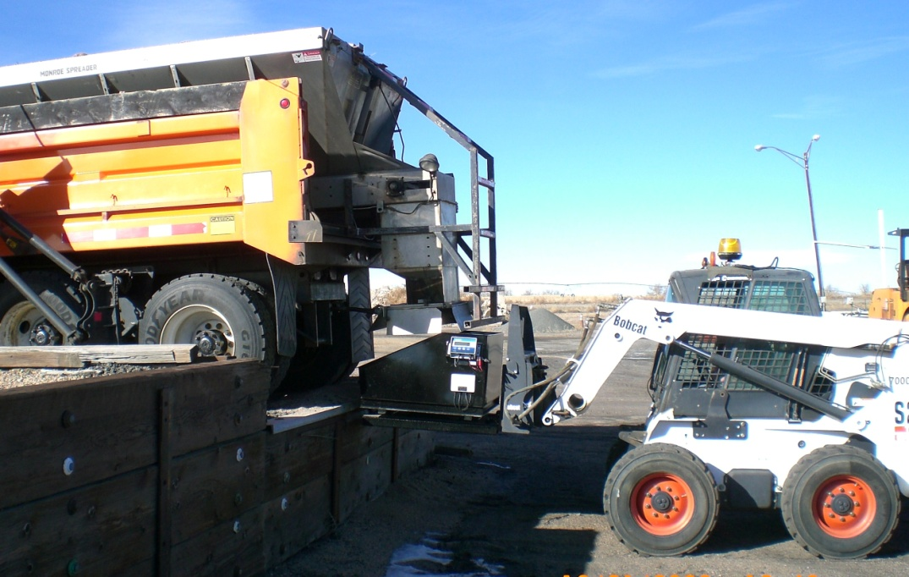

Slide 15
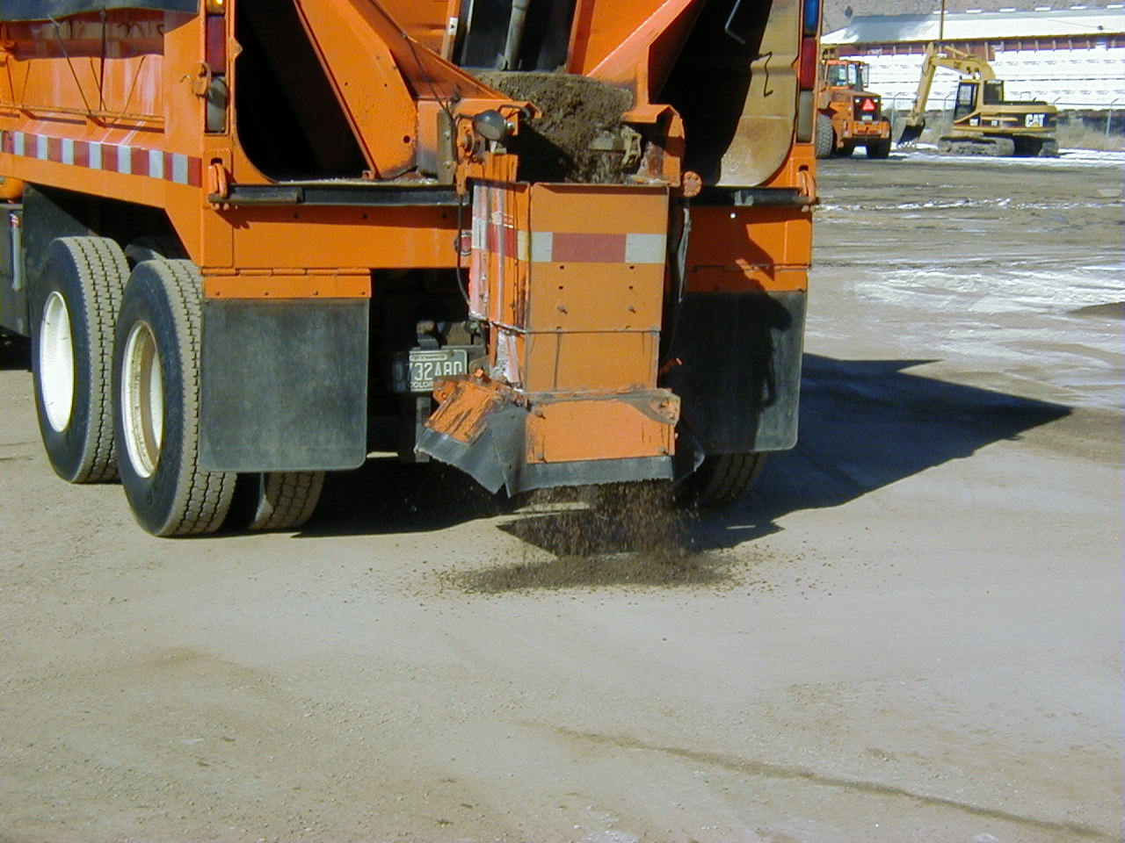

Slide 16
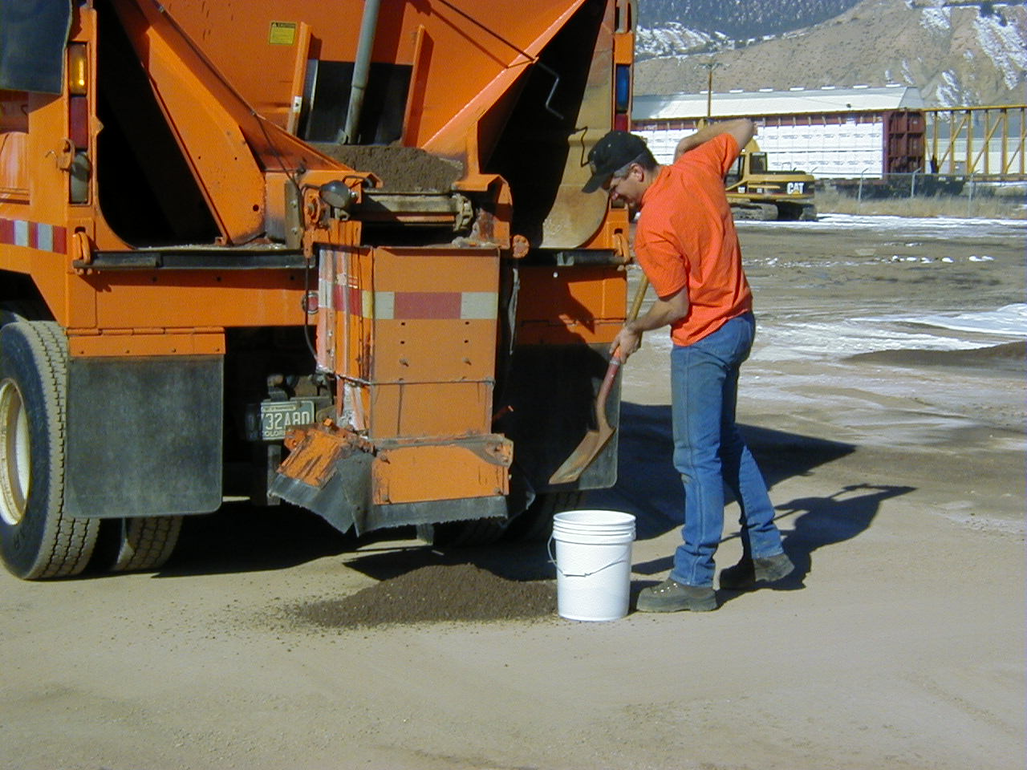

Slide 17
Remember - each truck needs to be calibrated
Notes:
A good idea to make a chart so you don’t have to start from scratch next year.

Slide 18
Liquid Unit Calibration
With the tank empty, fill tank completely full (1600), document total gallons loaded
Set computer to apply product at 40 gallons per lane mile
Note: Start mileage when you start applying product
Apply product for 10 miles (keep speed consistent)
X = lane miles per gallon
X = (start gallons – gallons remaining)/miles

Slide 19
Liquid Unit Calibration
Refill tank, document # of gallons
Compare computer read out to the amount that was placed back into the tank (these amounts should match)
Make sure computer speed and speedometer match
If amounts are different, adjust computer according to the manufacture’s manual under the calibration chapter

Slide 20
Trouble Shooting
Things to Check Prior To Changing Computer Settings
Is Pump Working
Plugged Nozzles
Electrical Connections
Hydraulic Connections/Level/Leaks
Valves Set In Spray Position
Filters Plugged
Is Flow Meter Working
If Truck is Equipped With Radar Make Sure it is Clean
Air connections

Slide 21
Before you adjust anything, make sure you check with the mechanic or a Supervisor

