Slide 1
Calibration
Notes:
The most important aspect of using alternative de-icers.

Slide 2
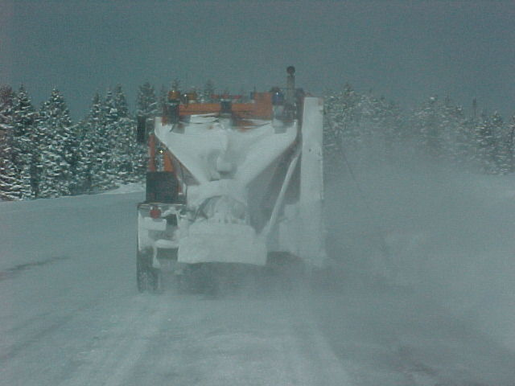
How much product are you applying?
Notes:
If you are not calibrated, you don’t know how much you are putting out. If this is the case, you may be wasting materials and costing us more money, creating a hazard with dilution of solution or damaging the environment.

Slide 3
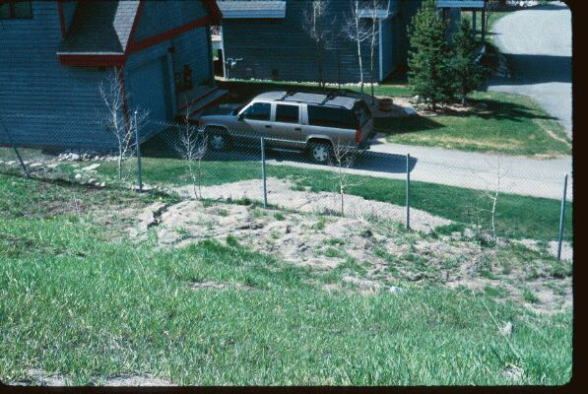
This is not beach front property
Notes:
This is sedimentation of sand from I-70 onto private property.

Slide 4
Enough sand?
Notes:
Too much sand? No accidents or car parts
What becomes of the sand now? What about it getting cast into the store fronts and vehicles by traffic? Have you ever tried to stop on sand?

Slide 5
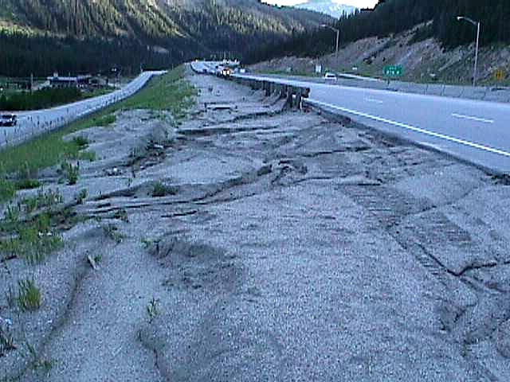
What are your objectives?
Our objective for these locations is to reduce the amount of sand being used.
Notes:
Top picture is Glenwood Canyon, look at the sand on the other side of the jersey wall.
The bottom picture is I-70 East of Eisenhower tunnel.

Slide 6
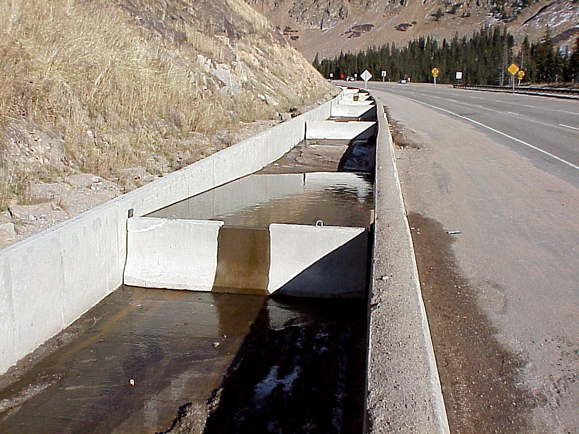
Notes:
West of Eisenhower tunnel. This was designed and built by Paul Dejulio. It allows sand to settle out of the snow as it melts.

Slide 7
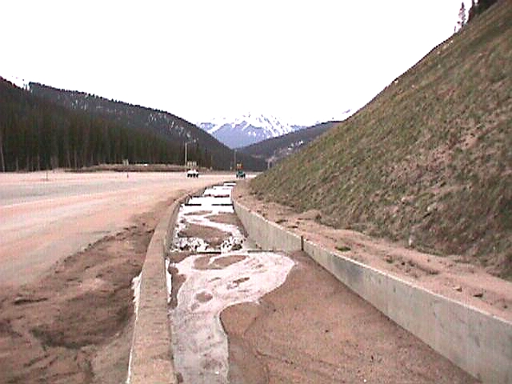
After One Season
Notes:
Sand is collected and used for building sound berms on I-70

Slide 8
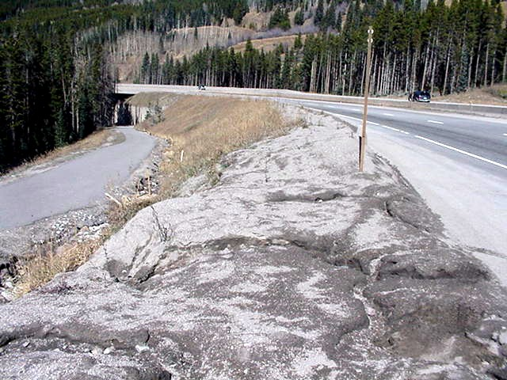
Notes:
Vail Pass next to bike/ped path

Slide 9
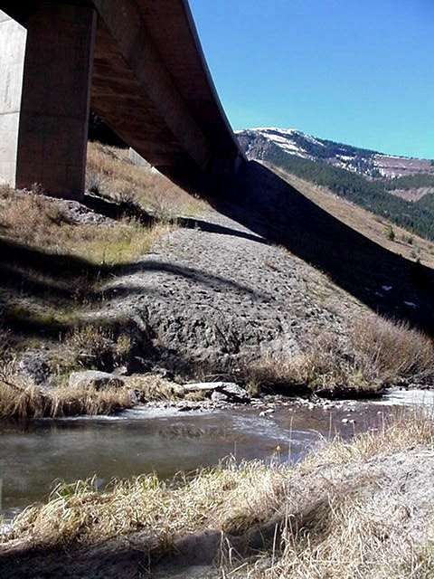
Notes:
Black Gore Creek under I-70

Slide 10
Calibration
How much Product is being applied per Lane Mile?
ALL Sand Trucks and Liquid Units must be Calibrated.
  Each unit must be calibrated for each product used
Do not Trust the Computer readouts in your Equipment.
Perform actual tests between Computer read outs and the amount of Product that is actually applied
Notes:
Our maximum on sand/salt is 500 lbs. per lane mile

Slide 11
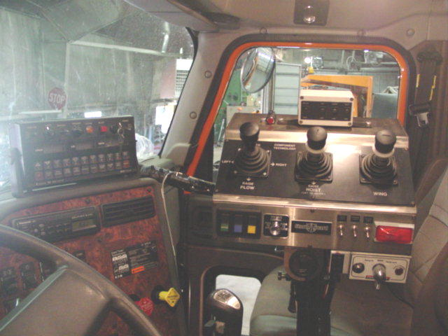
Notes:
There are a number of different types and manufacturers of computer controllers

Slide 12
Sander Calibration
Figure calibration at a 30 M.P.H.
  1800-2000 RPM’s
With the truck parked, run the belt for 2 minutes = one mile
Weigh the sand and adjust belt or gate accordingly
Set the flow rate so that (ex… 200 lbs. Is released in two minutes) 200 lbs. per lane mile is applied.
Notes:
There are a number of different methods and procedures to do this. Pick one that works for you and that is accurate.

