Slide 1
Did you do a Pre-trip?
Notes:
This truck was believed to have a small hydraulic leak in the engine compartment and was out of service for nearly one year before being rebuilt from this fire.

Slide 2
Vehicle Inspections

Slide 3
Equipment
Pre-Trip/Post-Trip
1st Step to Safety
Communicate Problems
Let others know what is wrong and fill out the work order or notification
Check your Equipment often
You never know what you might find
Know the areas on the equipment that are constantly under stress

Slide 4
Preventive Maintenance
Starts with Pre Trip Inspection
Inspections are used to protect CDOT investments
Review previous day post trip
Check all fluids under hood at the beginning of each shift and more often if needed
Check Tires Air Pressure Weekly with a Gauge
Check all fluids Monthly
Differentials
Transmission / Transfer Case
Hydraulic System
Grease equipment Monthly

Slide 5
Preventive Maintenance
Post Trip Inspection
Is Required by Federal DOT
49 CFR Part 396.11 Driver vehicle inspection report. Must be in writing.
Taught at CDOT Training Academy
Is Required on CDL exam, must demonstrate that you know what to inspect on Post trip to pass exam.

Slide 6
Preventive Maintenance Post Trip Requirements
Service Brakes
Park Brake
Steering Mechanism
Lighting devices and reflectors
Tires
Horn
Windshield wipers
Rear Vision mirror
Coupling devices
Wheels and rims
Emergency equipment

Slide 7
Preventive Maintenance

Slide 8
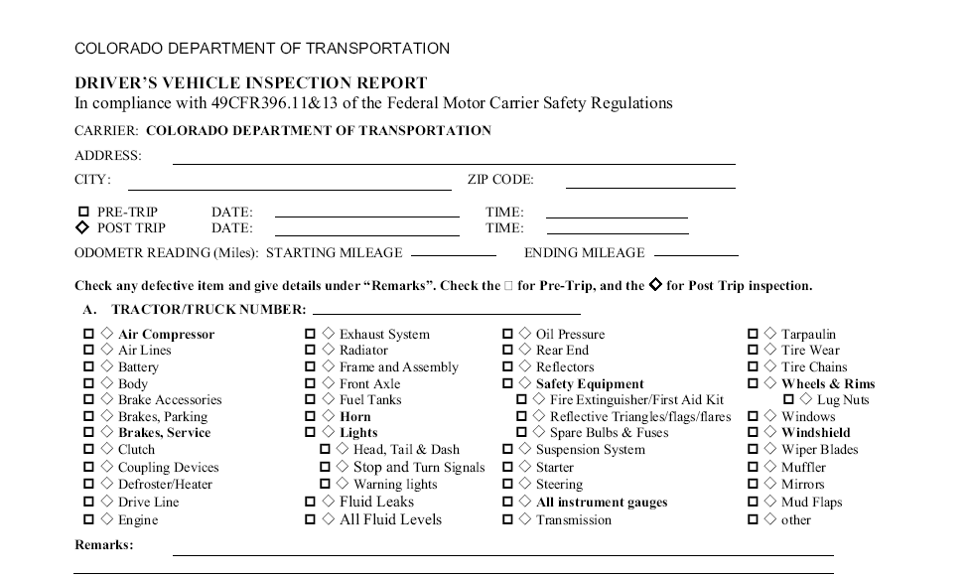
Notes:
Only check the box if there is a deficiency.
Never operate a piece of equipment that has an out of service criteria defect.

Slide 10
Preventive Maintenance
PRE/POST Trip Inspections.
Federal DOT is not concerned if there are any fluids in the engine, transmission, differential or transfer case, or if there are any fluids in the steering system or cooling system.
Their only concern is if they leak and if the unit is safe to operate.
CDOT DOES, we want to protect our investment. Make sure you check all fluids and they are in operating range.

Slide 11
Equipment
Attachments (These vary from unit to unit)
Plows, Wings, Blowers, Sanders, Spray Units
Calibration
You need to know how much product you are putting out
Preventative Maintenance
Makes all the Difference
Know the limitations and characteristics of your equipment

Slide 12
Attachments
Inspection, service, maintenance and use
Calibration
Plow blade inspection and safely changing them

Slide 13
Cleaning of Equipment
Proper cleaning in an approved area
Inspection of equipment and attachments
Monitor condition of patrol during cleaning
Perform during normal work hours
Notes:
Clean, clean, clean. A clean vehicle reduces the corrosion on our fleet. You should never park a vehicle after a storm without washing it off first. The corrosion of any chloride is intensified with the chemical reaction that takes place when the product is allowed to dry and then become wet again. Give example.

