Slide 1
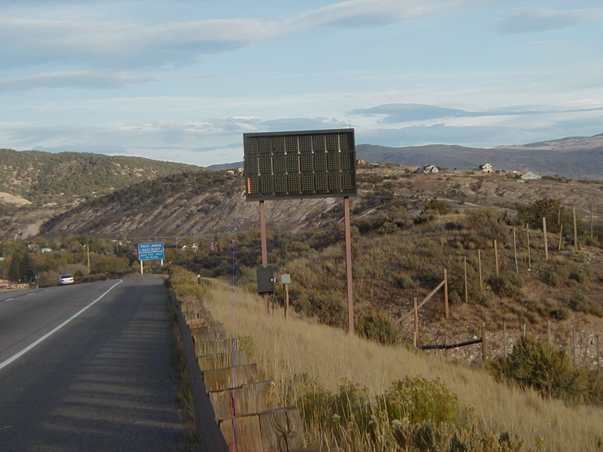
VMS Signs
Slow down while plowing.
Sign faces are expensive to replace.
Hard to clean without damaging sign face.

Slide 2
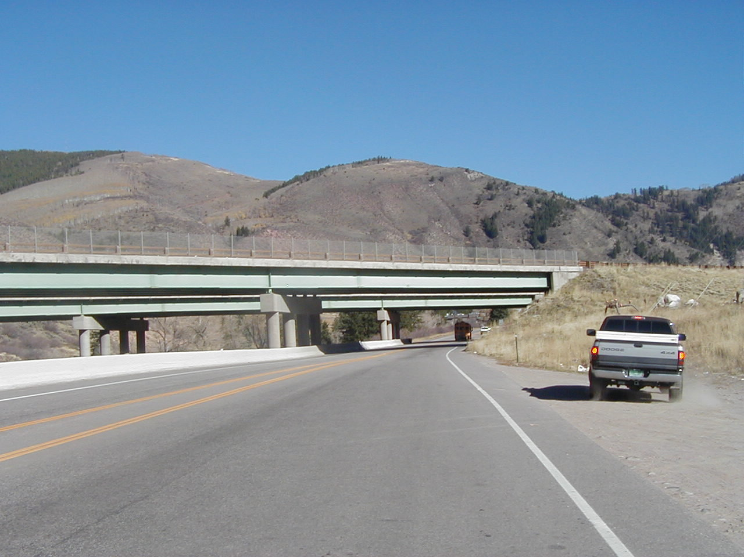
Snow Removal/Bridges
Slow down to keep snow from falling onto highway below
Only plow snow off bridges under controlled situations

Slide 3
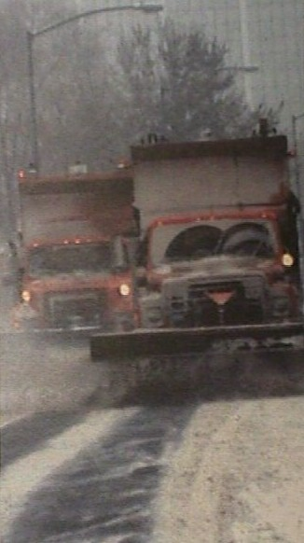
Plowing in Tandem
Avoid causing traffic back-ups
Maintain safe following distance
Try to prevent traffic from passing between trucks
Use warning signs when possible (VMS)
Do not pull walls during rush hour
Use caution, be alert
Time Of Day
Communicate with other Plows

