Slide 1
Hazards

Slide 2
Plow Hazards
Other Motorists
Fixed Structures
Pedestrians
Animals
Expansion Joints
Curbs
Mailboxes
Bridges
Rocks
Railroad Tracks
Manhole Covers
Drop inlets
Guardrail
Drifts
Snow pack
Water
Roadway Supers and Grades
Abandoned vehicles
Cattle Guards
Notes:
You need to do a pre-winter tour of your road with your crew and your supervisor, include any extra helpers you might get from Traffic, Engineering or Special Crews too. If you can’t include other helpers at least make one run with them when they show up so you can point out the hazards.

Slide 3
Hazards
Traffic
Attenuators
Soft Shoulders
Joints
RR Crossings
Over/Underpasses
Recreational Paths
Road Debris
Supers, Inclines, etc

Slide 4
Hazard

Slide 5
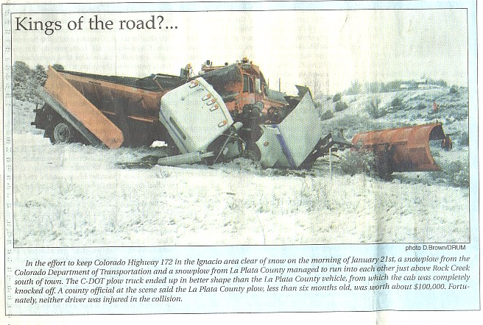
.

Slide 6
Danger
What is more dangerous to the
traveling public?
A long section of icy roadway…
OR
One short icy spot on a dry section of roadway.

Slide 7
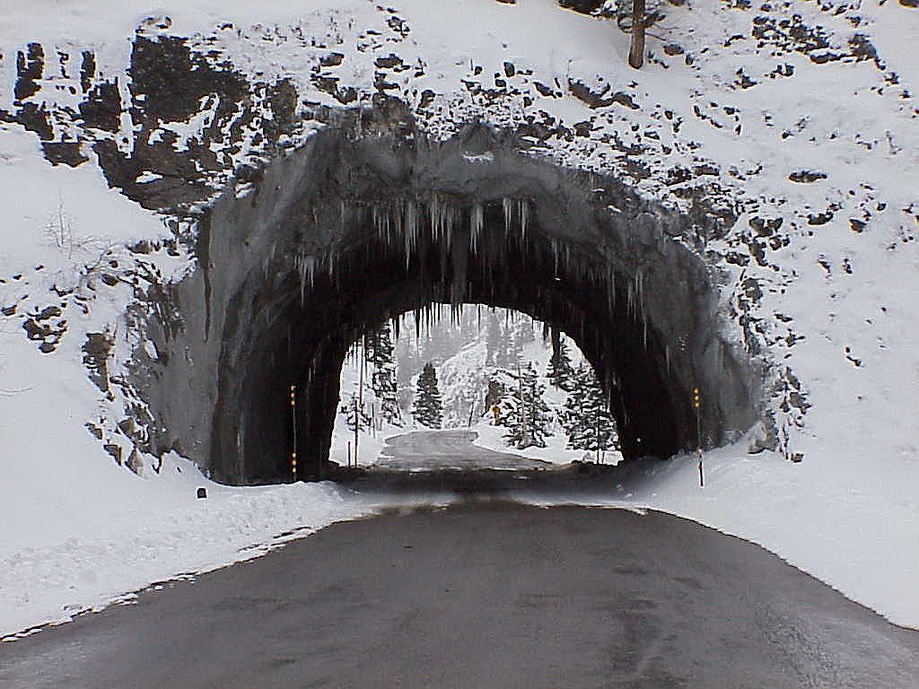
Shade and open sections mixed.

Slide 8
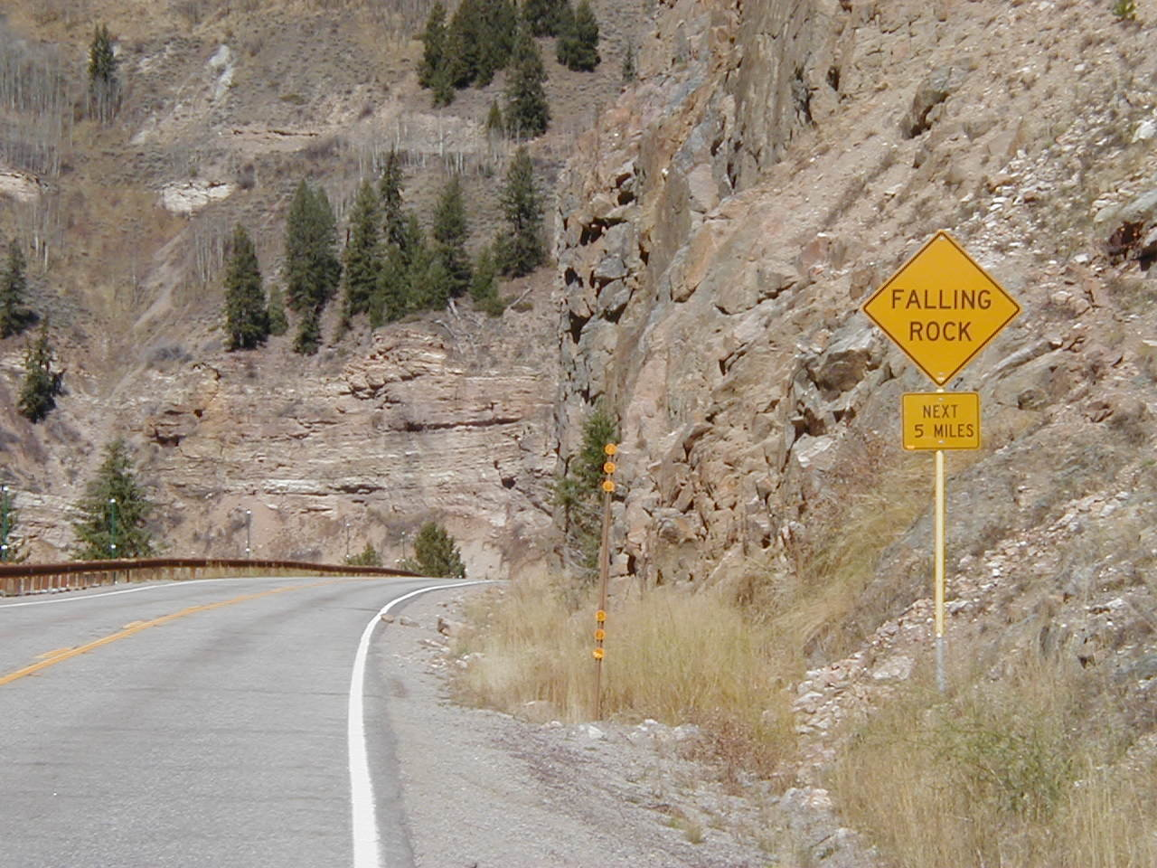
Plowing Rocks/Plow Busters
Slow Down
Keep plow turned against stops to avoid ram damage
Clean ditches before winter
Don’t leave a hazard

Slide 9
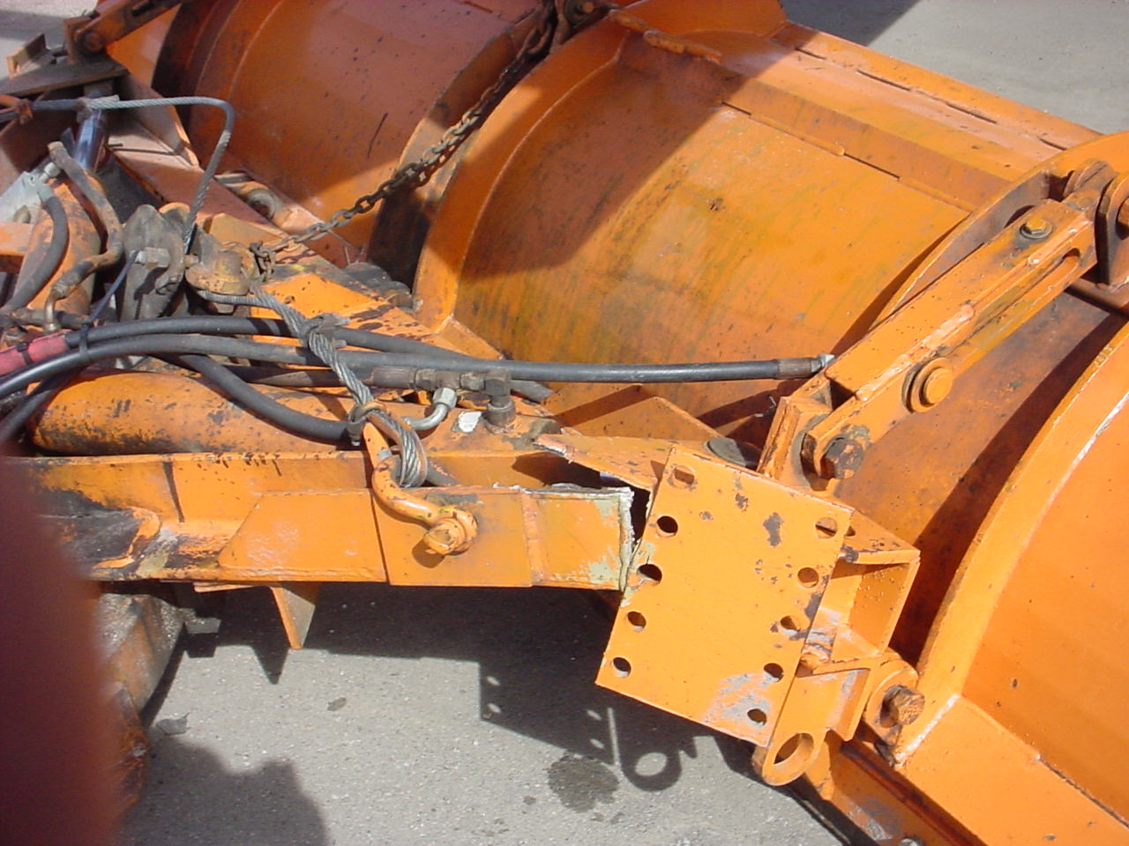

Slide 10
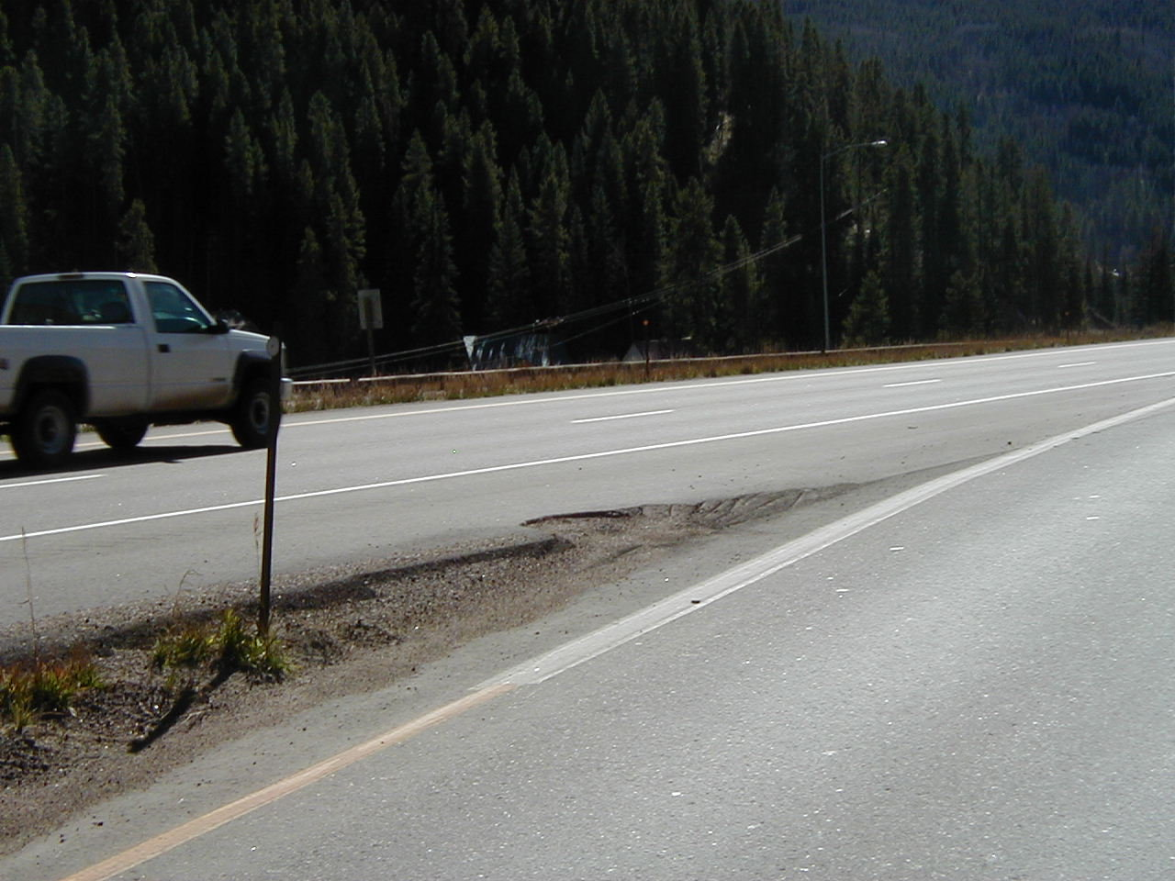
Snow Removal/Plow Busters
Use Flex Posts.
Move post to identify hazard.

Slide 11
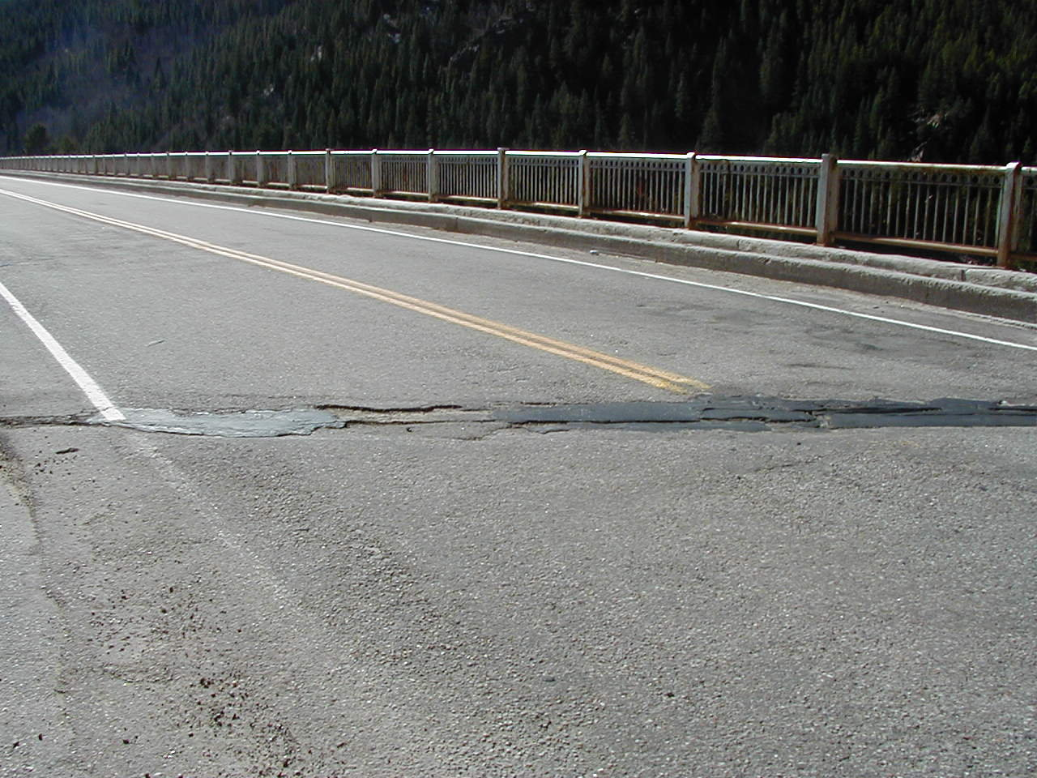
Snow Removal/Plow Buster
Always lift your plow prior to expansion joint
Expansion joints can change over time

Slide 12
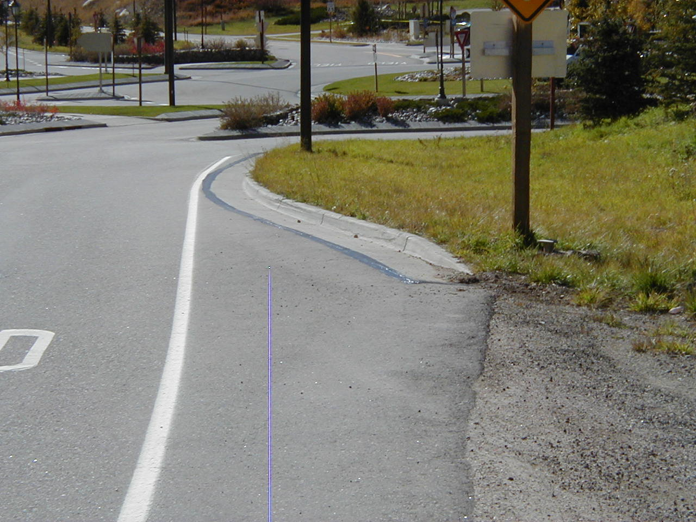
Snow Removal/Multi-Hazards
Notes:
Avon roundabout signs, curbs, dirt to asphalt transition, traffic

Slide 13
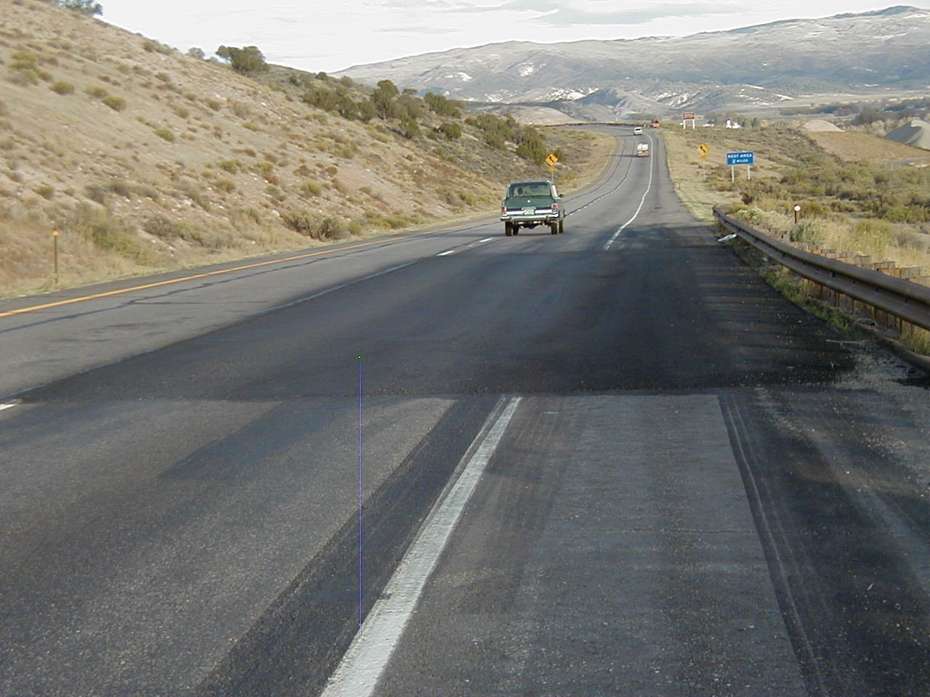
New Asphalt Patches/Plow Busters

Slide 14
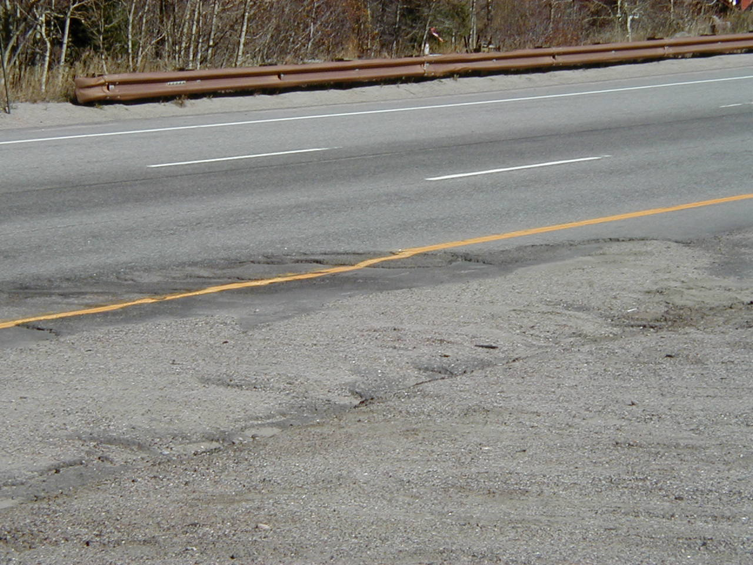
Turnarounds
Pick the time of day.
Will the plow hang up?
Will the snowplow fit.
Avoid stacking snow too high for sight distance.
Schedule cleaning times.

Slide 15
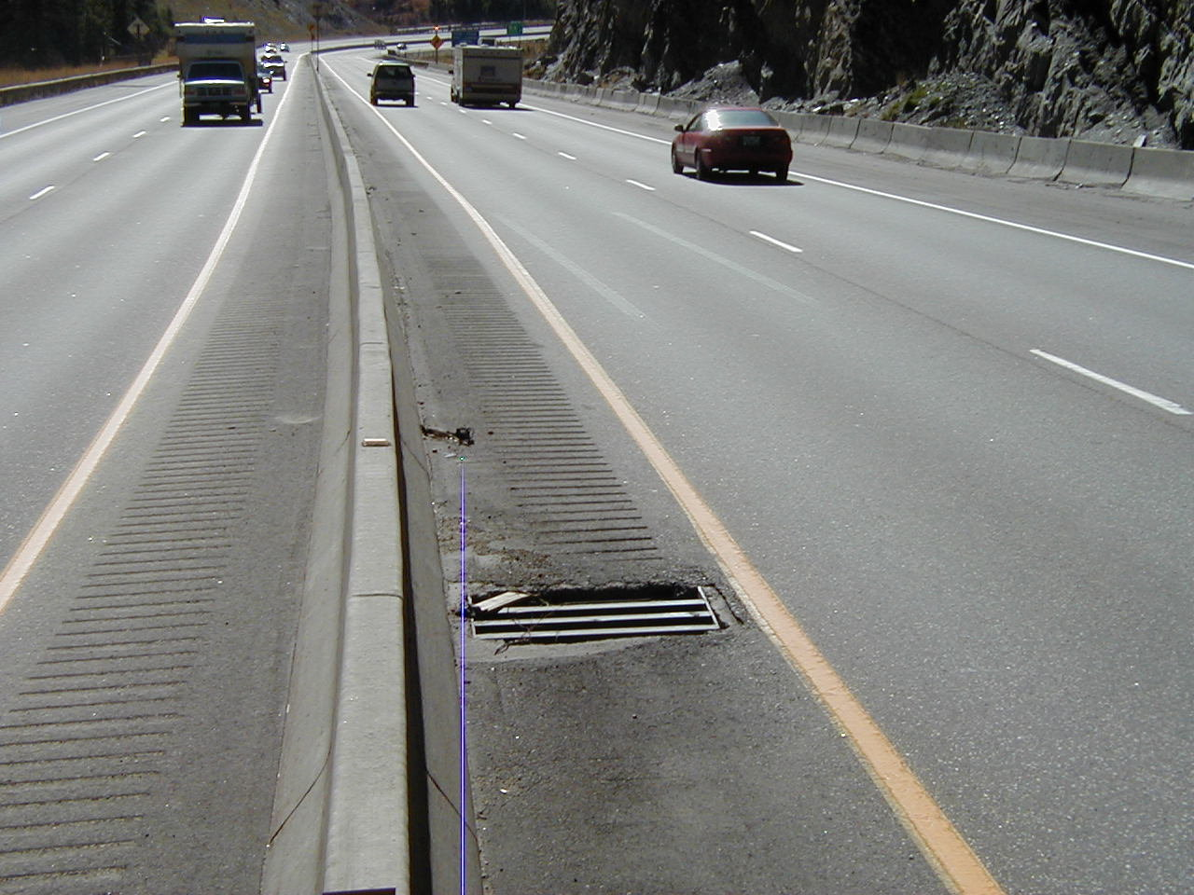
Snow Removal/Tire Busters
Tell your co-workers
Mark the Hazard
Check bolts, grates and concrete box
Contact your TMII or supervisor of any problems

Slide 16
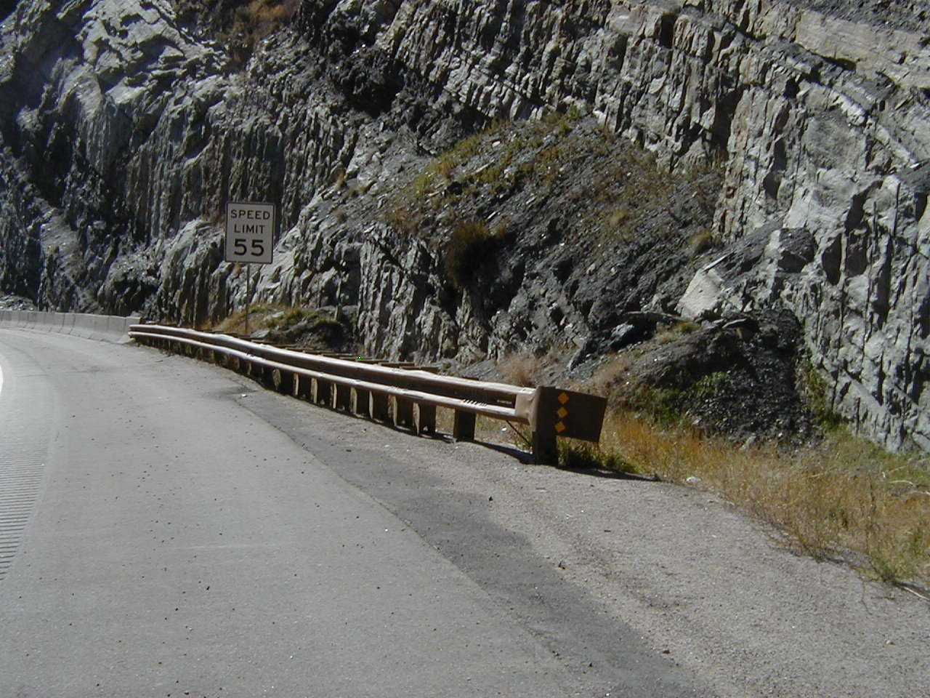
Snow Removal/Hazards
Mark your Hazards early
Know where your Hazards are located.

Slide 17
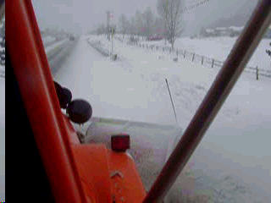
Is guardrail a hazard? Video Link
Notes:
You can bet it is. You can square the angle of your plow and carry snow to the end of obstacles such as this.

Slide 18
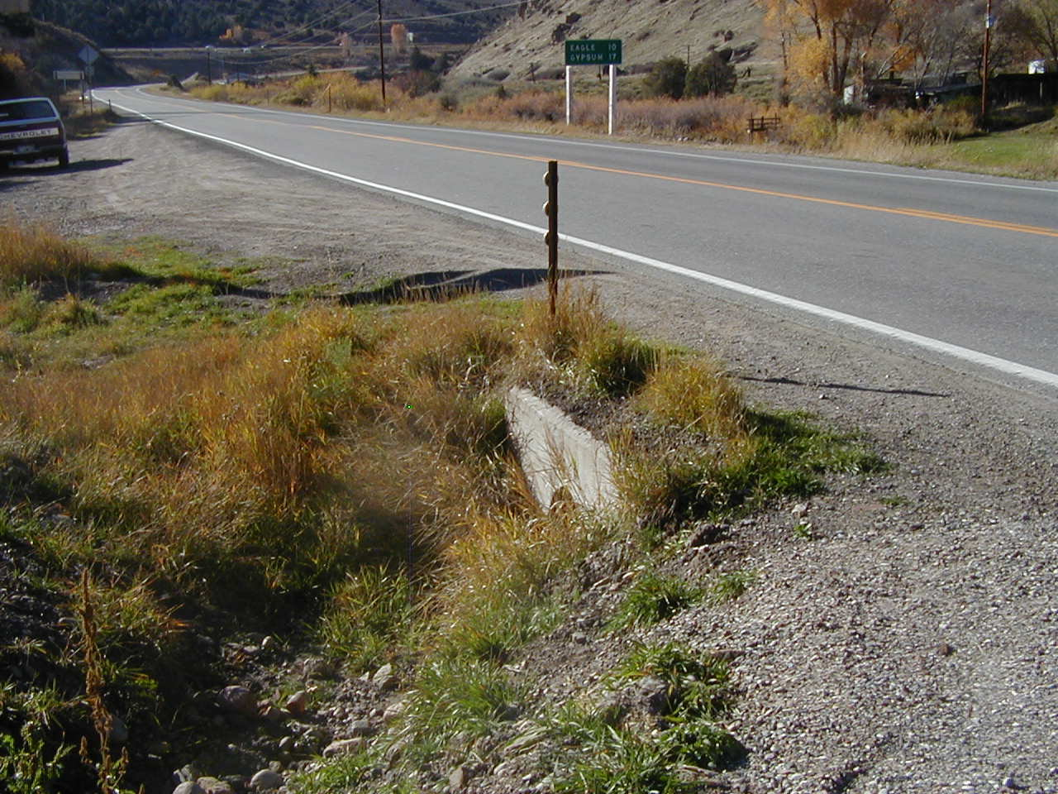
Snow Removal/Hazards
Take advantage of learning your Patrol while performing other maintenance operations.
When winter is here, this won’t look the same.

Slide 19
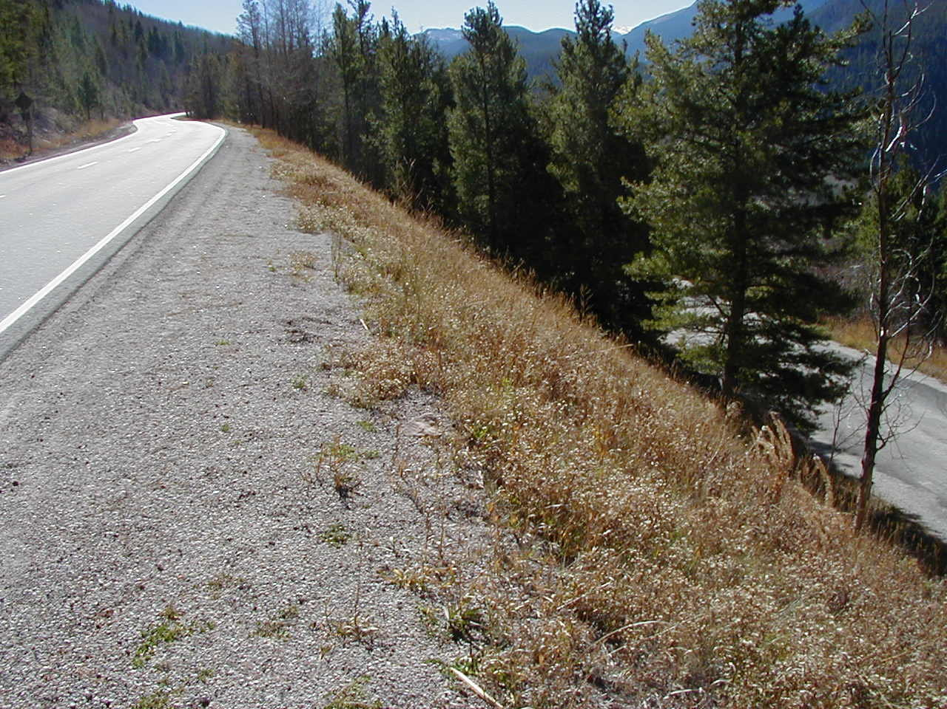
Shoulder Drop Off
Keep snowplows on paved surface.
Use appropriate equipment to remove large amounts of snow.( motorgraders, loaders, snowblowers, etc.)
Notes:
We don’t want drop offs because of safety and erosion problems but we do want drainage off of our road surface and away from our road base. We need to have the structural support to our road surface too.

Slide 20
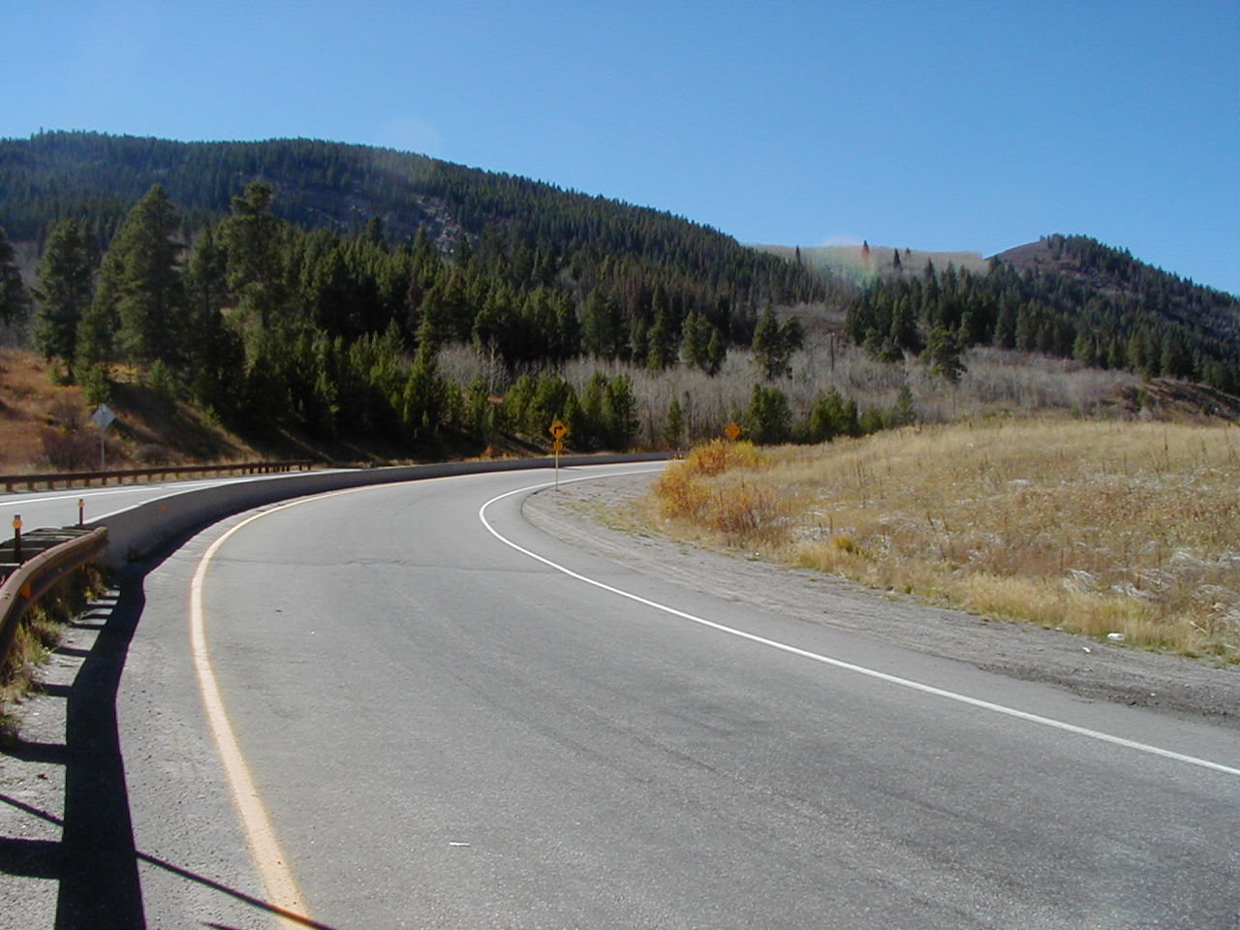
Snow Removal/Pulling the Wall
Plan your times.
Avoid plowing left.
Remove snow during the storm.
Don’t leave a hazard.
Team Up.
Use Law Enforcement.
Advance Warning VMS.

Slide 21
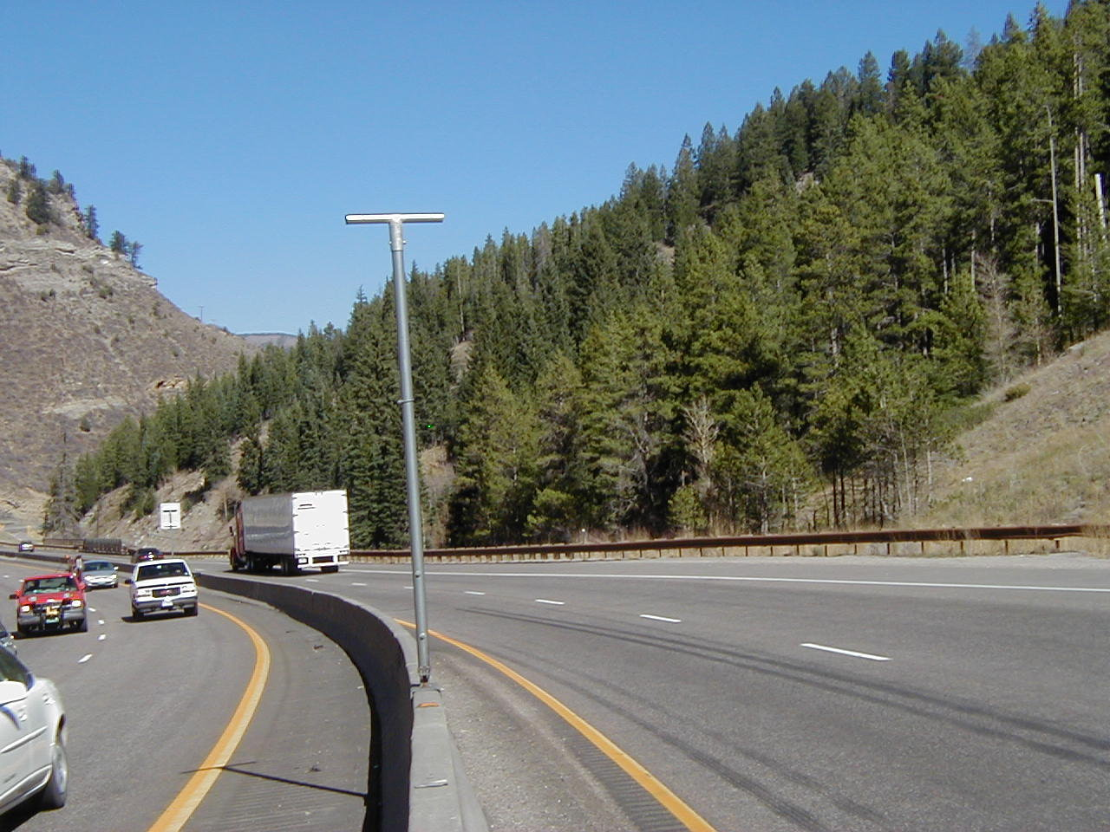
Mirror vs. Sign

Slide 22
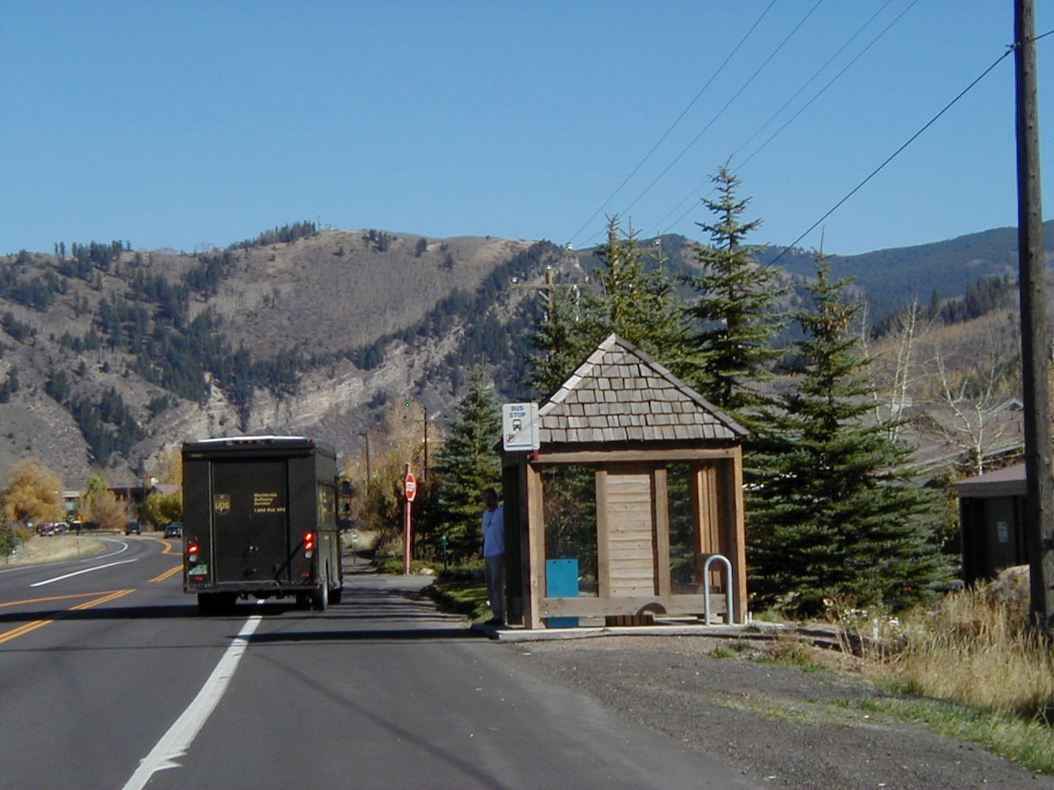
Bus Stops
Slow Down
Watch for Pedestrians Out of Sight
Schedule Clean Up After Peak Hours
Keep Area Treated Well With Sand, Mag, Etc.
Notes:
Remember someone could be in there and someone will have to clean up the mess

Slide 23
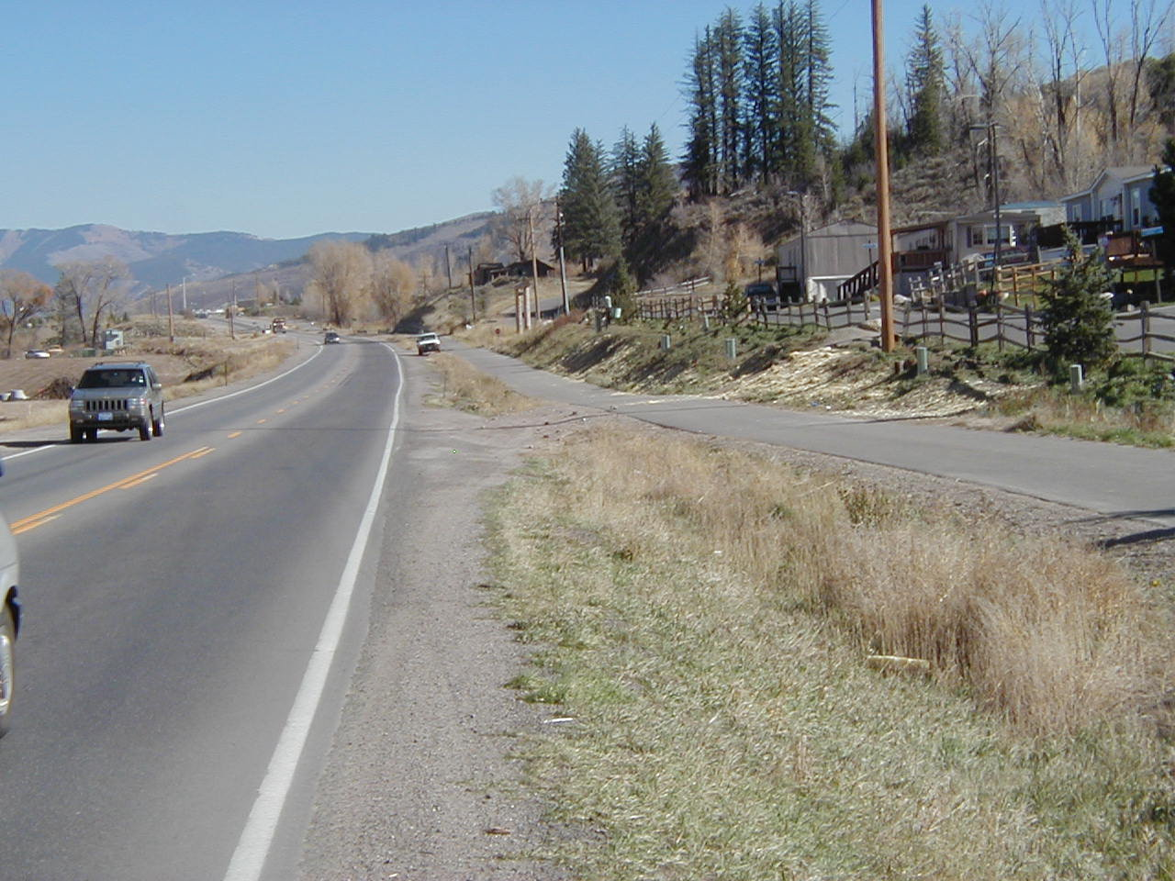
Awareness…
Bikers
Snowmobiles
Cross County Skiers
Pedestrians walking at night
Hidden areas

Slide 24
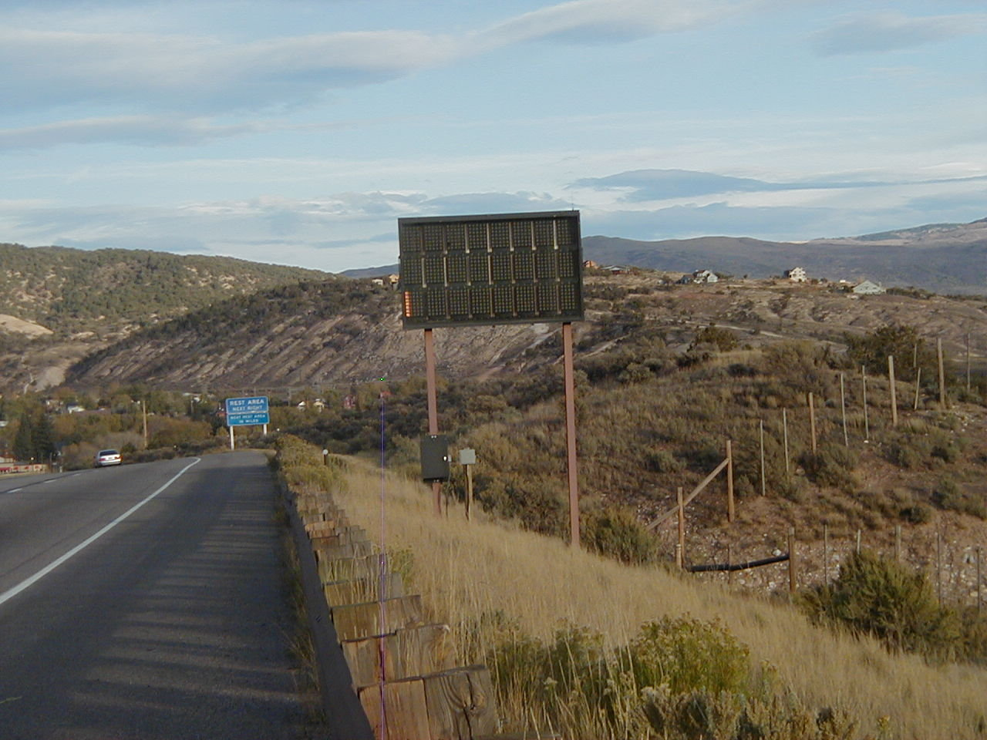
VMS Signs
Slow down while plowing.
Sign faces are expensive to replace.
Hard to clean without damaging sign face.

Slide 25
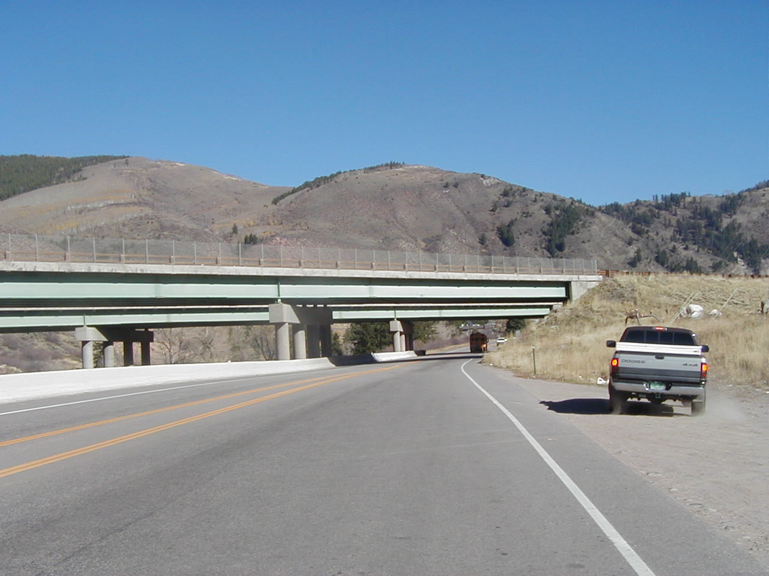
Snow Removal/Bridges
Slow down to keep snow from falling onto highway below
Only plow snow off bridges under controlled situations

Slide 26
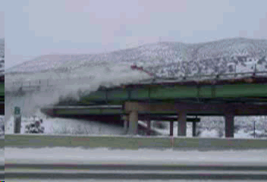
Would you do this? – Video Link

Slide 27
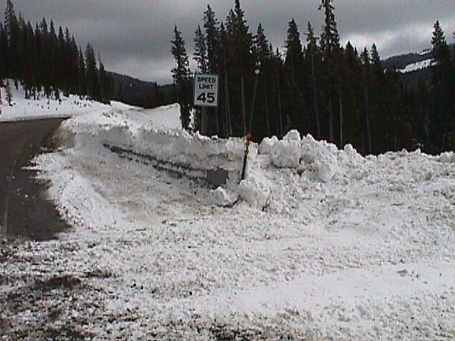
Safety Features
Use caution when cleaning around safety features, i.e. guard rail end treatments. Make sure you complete the process.
Notes:
These ends won’t perform as they are designed or intended to if there is snow pack and ice preventing them from performing.

Slide 28
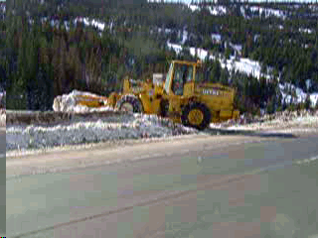
What are the hazards? – Video Link
Notes:
No lights, no TC, working around guardrail. What about support under where he is pushing the snow.

Slide 29
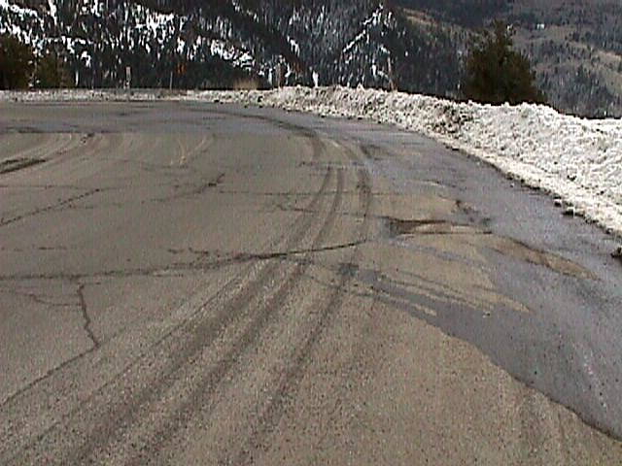
Remove all snow from supers and medians that might cause melting and refreezing onto the road surface.
Notes:
As the snow melts it runs across the road and freezes as the temps drop. The water itself causes damage to the road surface.

Slide 30
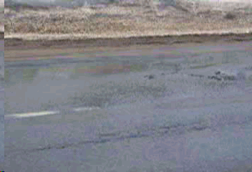
Water on Road Makes More Work – Video Link
Notes:
Water pumping washes the asphalt from the aggregate and allows the aggregate to pop loose. Keep water off the road. Look at the damage that is being created here.

Slide 31
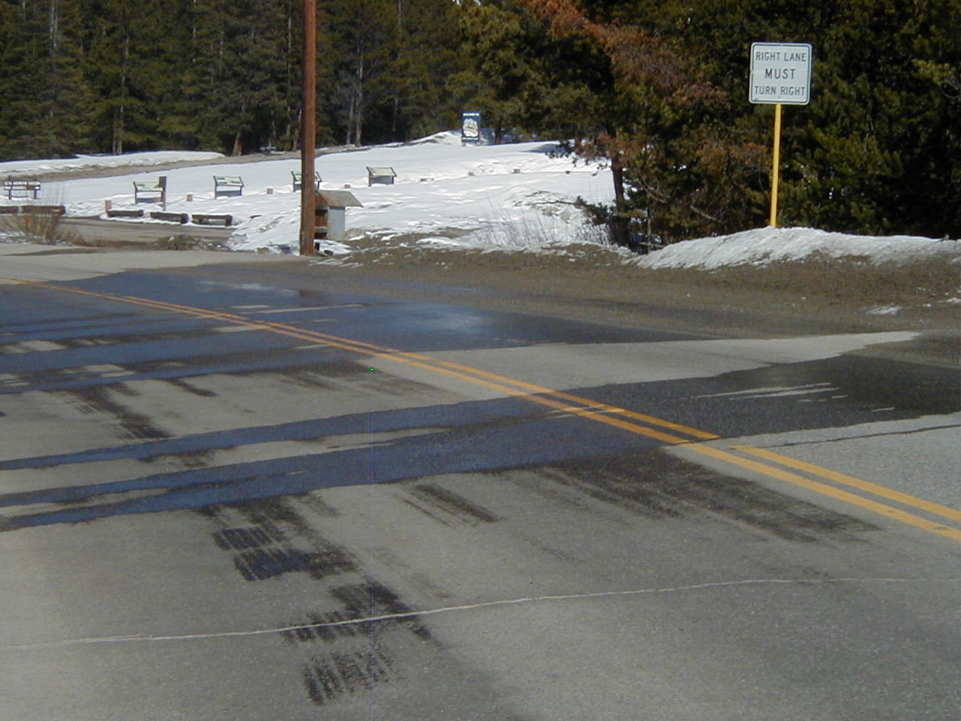
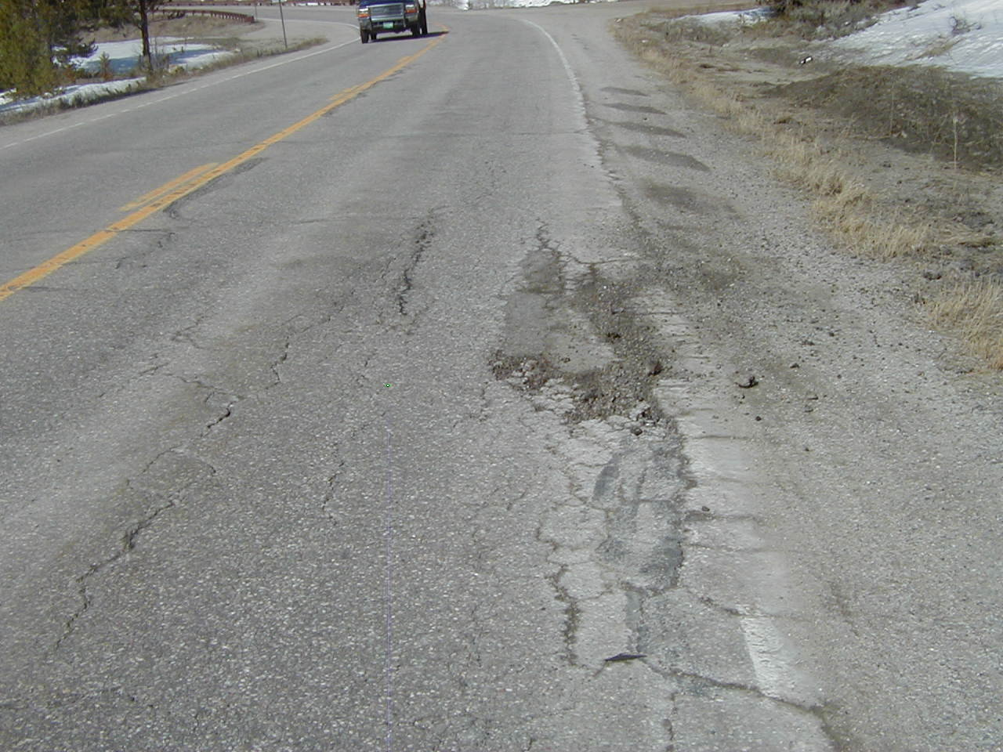
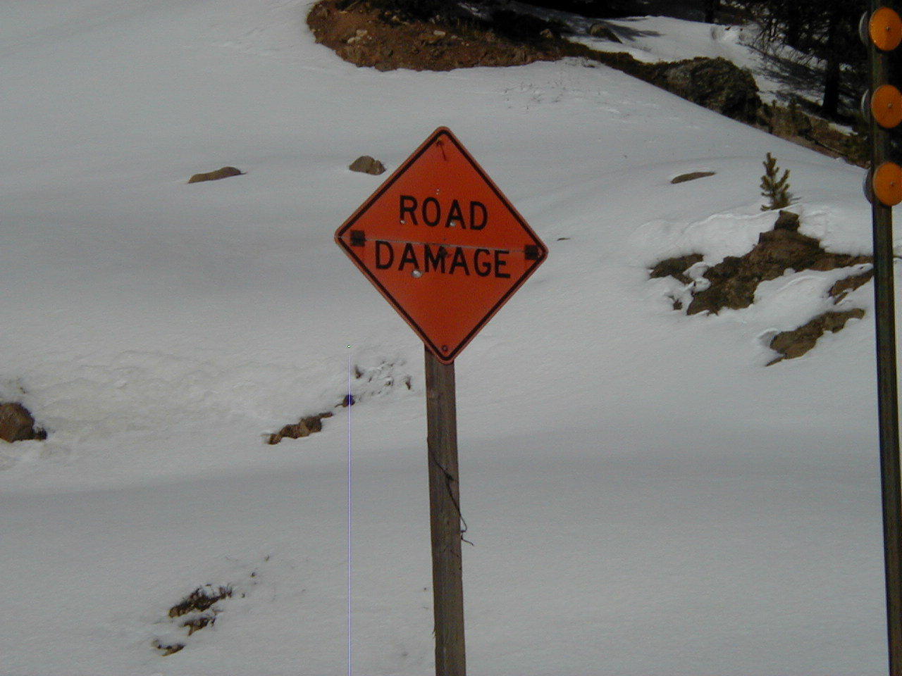
Good Mtce. practices may save accidents & road damage
Day 1
Day 2
Day 3

Slide 32
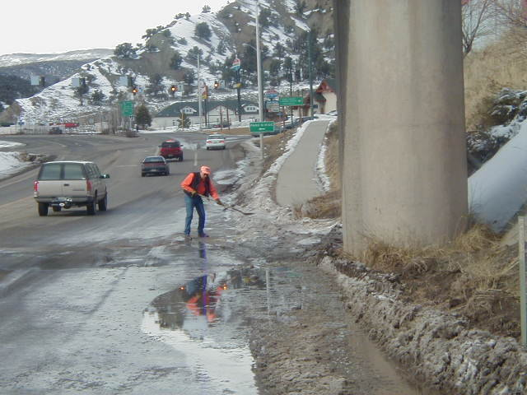
You may need to do hand work
Notes:
Yes you have to do hand work. Get the water off and keep it off our road surface and shoulders.

Slide 33
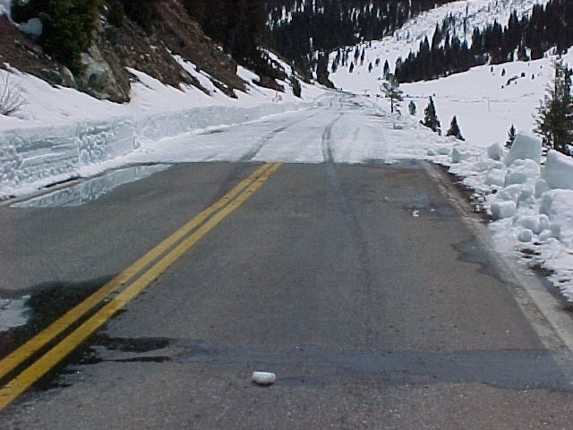
Do not leave hazards at patrol boundaries
Notes:
Staged picture. This is Independence Pass where they started clearing from the previous days work.

Slide 34
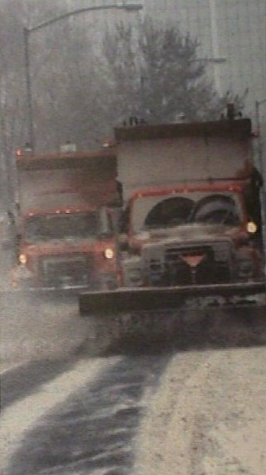
Plowing in Tandem
Avoid causing traffic back-ups
Maintain safe following distance
Try to prevent traffic from passing between trucks
Use warning signs when possible (VMS)
Do not pull walls during rush hour
Use caution, be alert
Time Of Day
Communicate with other Plows

Slide 35
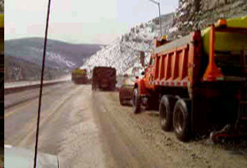
Plowing in Tandem – Video Link

Slide 36
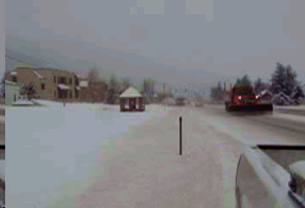
Fixed Structures – Video Link

Slide 37
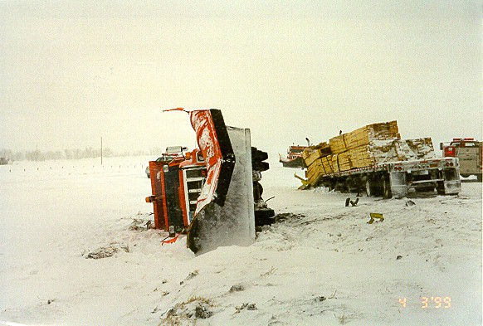
Other Drivers?

