Slide 1
Accidents
Accident scene safety
Making the scene safer
Proper reporting of accident
PD
Identify and mark hazards on patrol before they cause an accident
Pre/post trips

Slide 2
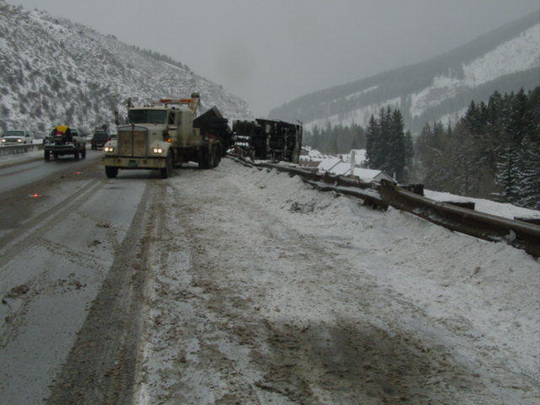
Accidents

Slide 3
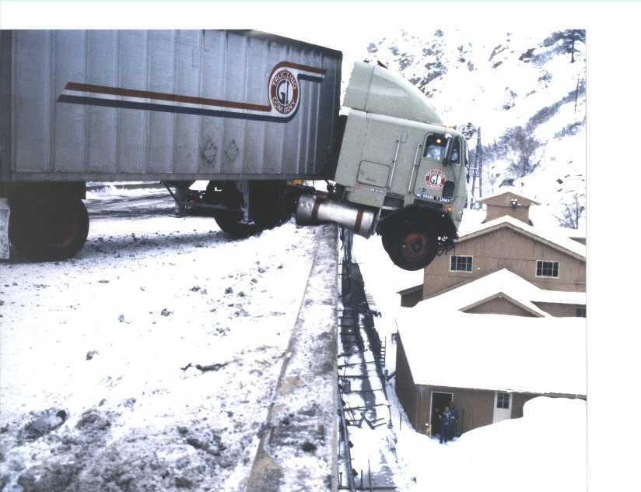
Notes:
Shoshone Power Plant down below.

Slide 4
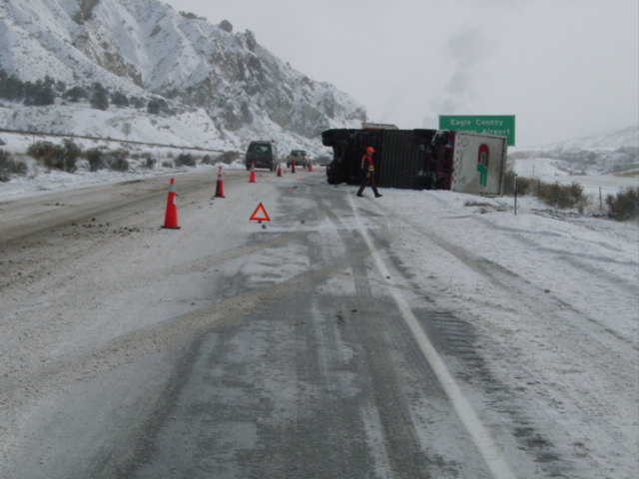

Slide 5
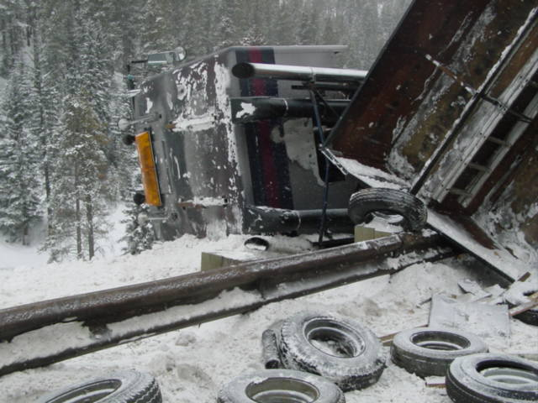

Slide 6
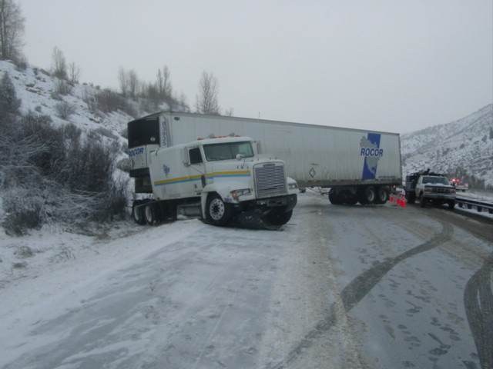

Slide 7
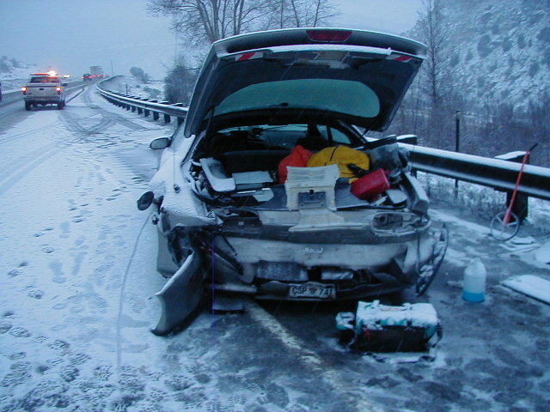
Notes:
Nobody is safe out there, look at this license plate. Yep, CSP

Slide 8
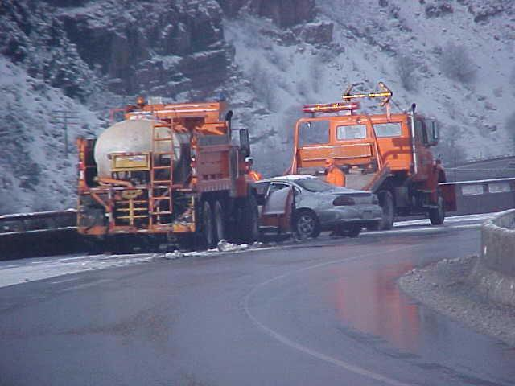

Slide 9
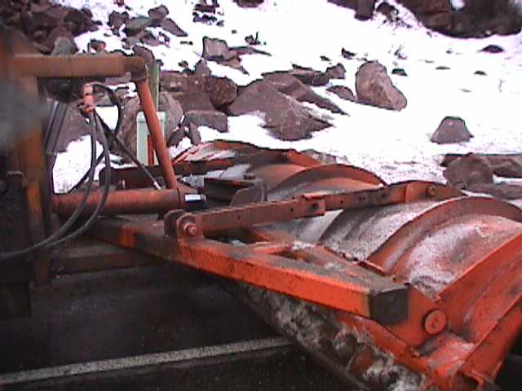
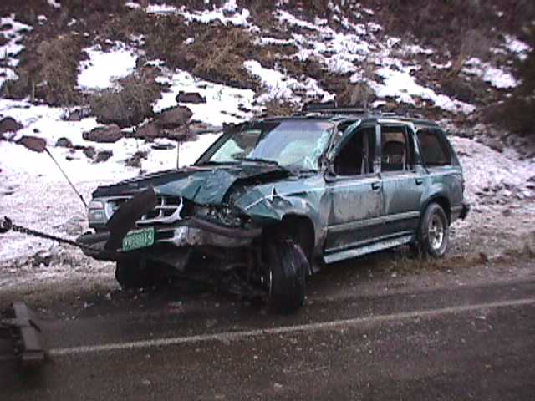
Snow Plow -vs- Explorer

Slide 10
Is the person taking this video your responsibility? – Video link

Slide 11
Safe Practices
Remove all snow from supers and medians that might cause melting and refreezing onto the road surface.
Take care that abrasives are not cast into or against other vehicles on the road.
Caution, “hooking or sucking through” the pack may cause the unit to suddenly move in the opposite direction.
Notes:
Plow to the right when you can and only plow to the left when you have to.

Slide 12
Safety Practices
When plowing snow, exercise great care meeting and/or passing vehicles to avoid throwing a blanket of snow on their windshields.
High speeds are conducive to throwing snow into areas causing property damage, especially in cities and towns, i.e. advertising signs, windows, parked cars, over passes, fences and mail boxes.

Slide 13
Safety Hazards
Guardrail ends
Crash attenuators
Soft shoulders
Expansion joints
Bridge approaches
Rail road crossings
Roadway supers
Traffic
Overpasses
Bike paths & side walks
Speed
Parked/abandoned cars
Man hole covers
Pedestrians
Rocks
Cattle guards

Slide 14
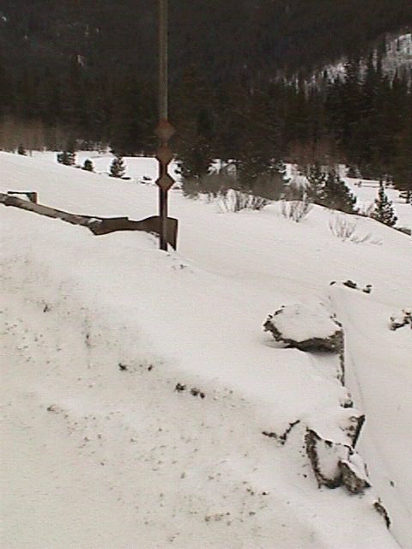
Use caution when cleaning around safety features, i.e. guard rail end treatments.

Slide 15
When plowing snow…
Exercise great care when meeting vehicles
Give them room (we can look intimidating to them)
Don’t throw sand on them
Remember that they might be blinded by the cloud of snow being thrown up

Slide 16
Potential SAFETY Hazards
Backing
Hooking/Unhooking
Inclement weather
Road conditions
Moving traffic
Pinching/Crushing
Slip, trip & fall
Unsecured loads
Over loaded/over width equipment
Popping pack
Visibility
Notes:
Parked cars, snow machines, pedestrians and animals are a few more hazards that can be encountered.

Slide 17
Never…
Use unsafe equipment
Use unapproved chain and load binders
Lift with your back. Get help and use lifting equipment as needed.
Trust the hydraulic system. When changing blades or performing other work on plows, use safety chains and/or protective blocking.

Slide 18
Always…
Have Supervisor/lead-worker verify that operators are capable and qualified on each type of equipment before allowing the equipment to be operated unsupervised.
Review Safe Operating Guides for applicable equipment and perform pre-operational checks.

Slide 19
Safety…
In order to ensure the safety of the motoring public, we must prioritize our services. All hazardous conditions must be prevented or taken care of as quickly as possible.

Slide 20
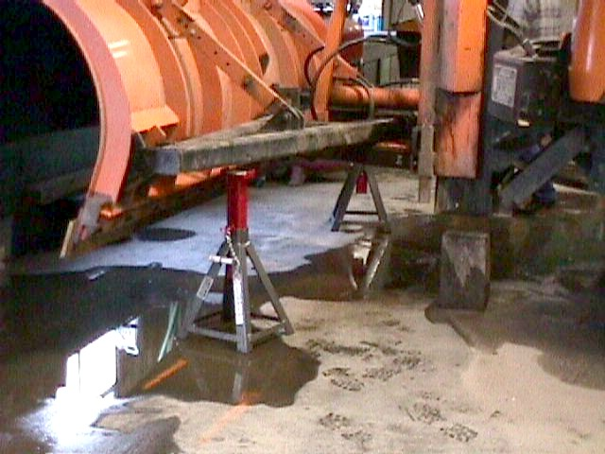
Safety
Notes:
Always block up or use safety locks to keep all raised equipment in place.

Slide 21
Driver Requirements
CDL license
Class B with tanker endorsement (for sprayer operations)
Air brakes
Registration
Proof of insurance
Notes:
The idea here is that you know this stuff and you are a professional and know the right thing to do.

Slide 22
Safety…
Clean and maintain all lights during snow removal.
Plowing against traffic should only be done when no other alternative exists; the area must be protected by traffic control.
Prevent hitting guard rail, delineators, sign posts, rail road crossings, bridge joints and other structures.
Run a cold cab to prevent windshield icing

Slide 23
Safety…
Take care that abrasives are not thrown into or against other vehicles on the road.
Caution, “hooking or sucking through” the pack may cause the unit to suddenly move in the opposite direction.
Do not assume the ROW is yours when plowing.

Slide 24
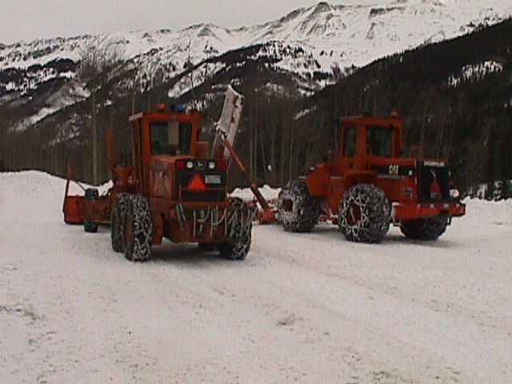
Safety-
Keep lights and windows clean on your equipment during your shift
Don’t take chances, follow the law
Know where obstacles are and prevent hitting them
Slow and Steady wins the race
Know what is around you and avoid causing damage to others

Slide 25
Conclusion
Safety is the responsibility of everyone. Follow safe practices and be safety conscious in everything that you do. Your family, co-workers, and the traveling public depend on it!

