Slide 1
Quality Control
What’s the big deal? We order material and we get what we ordered.
Test the material
Liquids- test the specific gravity and send in a sample
If you see something wrong or suspicious- tell your supervisor
Get what you order-keep accurate records on quantities ordered and used
Make adjustments
If it isn’t working, try a different application rate, adjust up or down, use the minimum you can get results with
Stay open minded and try new products
Communicate and learn from others mistakes, failures, achievements and success’
It is absolutely vital. Every experienced user will inform you just how vital it is. If you do not have a quality control process in place you can receive very different materials. This translates into effective vs. ineffective operations, environmental contamination, handling difficulties, equipment issues, and on and on.
How essential is a quality control program?
Notes:
One of the most important things they can do – and the most often overlooked by new users until they learn their lesson the hard way.
Many factors making it more difficult for them --- not visual like other materials, new to them, do not see the potential downside by not having a good QC program in place.
If specific gravity test doesn’t met the material ordered, we can reject the delivery.

Slide 2
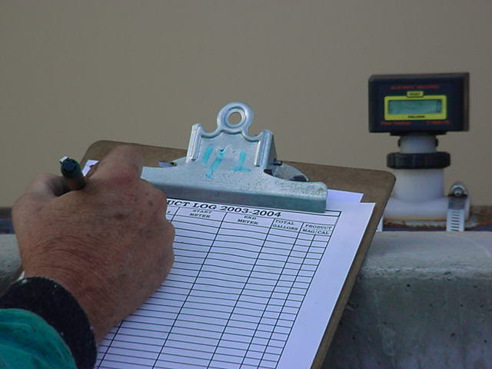
Paper Work
Get total gallons loaded & zero meter, if equipped at your fill station, otherwise use what you get off your truck computer that you used.
Fill out product usage log

Slide 3
Documentation
SAP Workorders
Patrol log
Material usage log
Equipment work orders
Fuel logs
Time sheets
Diary
TAPER log

Slide 4
T A P E R
T= Temperature
A= Application
P= Product
E= Event
R= Results

Slide 5
Notes:
Go over this sequence of events as illustrated on this report, pay particular attention to the changes that took place in the highlighted entries.
This taper log really paints a good picture of what was done, when it was done, how it was done, who did it with what and what the outcome was like. If you had this information coming on to shift, would you really even need to talk to the person you are relieving?

