Slide 1
How Do Deicers Work?
Radiator Example
12 Qt Radiator
Filled with
12 Qt Anti-Freeze
FP = 30F
12 Qt Radiator
Filled with
3 Qt Water &
9 Qt Anti-Freeze
FP = 10F
12 Qt Radiator
Filled with
6 Qt Water &
6 Qt Anti-Freeze
FP = -34F
12 Qt Radiator
Filled with
9 Qt Water &
3 Qt Anti-Freeze
FP = 10F.
12 Qt Radiator
Filled with
12 Qt Water
FP = 32F
FP = Freeze Protected
Just like anti-freeze, chemical deicers
depress the freeze point of water.
Notes:
The theory is that straight water will freeze. As liquid de-icers dilute out, they will freeze also, this is why you have to reapply.

Slide 2
Magnesium Chloride
27% to 30% Magnesium Chloride and 70% to 73% water.
1.5 % by weight corrosion inhibitor
Specific gravity of 27% is 1.271
Material freeze point of -3⁰ F
Working temperature range > 16 ⁰ F

Slide 3
Mag-Chloride
PRO’S
Can be utilized for ant-icing and de-icing applications.
Reduces Sand.
Reduces Accidents.
Reduces Sand Clean up by Maintenance Personal.
Improved Levels of Service
Reduces Personal and Public Property Damage
CON’S
Use care during heavy precipitation and cold temperatures.
Use care on snow pack.
Public concerns.
Increased material costs.
Avoid using before crack pouring operations.
May increase Vehicle Problems
Increases Traffic Speed
Perception of Pre-wetting

Slide 4
De-icing
De-icing is simply removing snow and ice that has bonded to the road surface
De-icing is more difficult
Quantities depend on Conditions
Temperature dependent
Moisture dependent
Product May dilute and Refreeze
Additional Storage May be Needed
And if goal is to maintain wet roads regardless, Cost will be a Factor

Slide 5
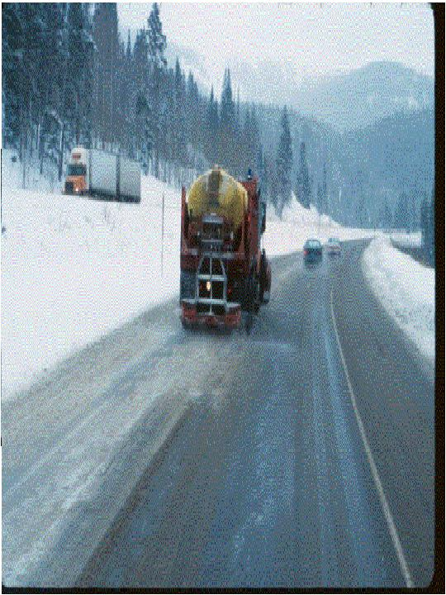
De-Icing 30 to 80 Gallons Per –Lane Mile

Slide 6
Cold Temperature Modified Mag
90% Mag Chloride (27-30% solution)
10% Corn by-product
Works at lower temperature than straight Mag Chloride

Slide 7
Example: Magnesium Chloride Specific Gravity Chart
% By Weight Specific Gravity Freezing Point F Freezing Point C
10
11
12
13
14
15
16
17
18
19
21
21
22
23
24
25
26
27
28
29
30
1.086
1.096
1.105
1.114
1.123
1.132
1.142
1.151
1.161
1.170
1.180
1.190
1.200
1.210
1.220
1.230
1.241
1.251
1.262
1.273
1.283
17.9
15.7
13.1
10.3
7.3
4.0
0.4
-3.5
-7.7
-12.2
-17.2
-23.0
-27.0
-20.0
-14.0
-10.0
-6.0
-3.0
-1.0
1.0
3.0
-7.8
-9.1
-10.5
-12.1
-13.7
-15.9
-17.6
-19.7
-22.1
-25.6
-27.4
-30.5
-32.8
-28.9
-25.6
-23.3
-21.1
-19.4
-18.3
-17.2
-16.7
Concentration testing is just one use for the chart.
Notes:
Note the optimum working/effective percentage. Know that if you use 30% it will take longer to dilute to that point, but it will stay on the road longer, where 27% will get there quicker but dilute out and need a follow up application sooner.

