Slide 1
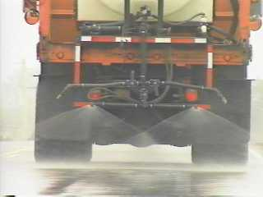
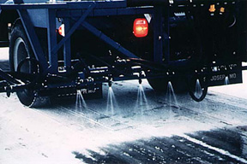
How are Anti-icing and De-icing Different?
Anti-Icers:
Placed before icing occurs.
Prevent the bond between frozen precipitation and pavement.
Secondary function is to melt snow and ice.
Proactive.
Typically liquid.
Deicers:
Placed after precipitation occurs.
Remove the bond between frozen precipitation and pavement.
Primary function is to melt snow and ice.
Reactive.
Can Be Both Liquids and/or Solids

Slide 2
Notes:
Chemical layer prevents the bond of snow to the road.

