Slide 1
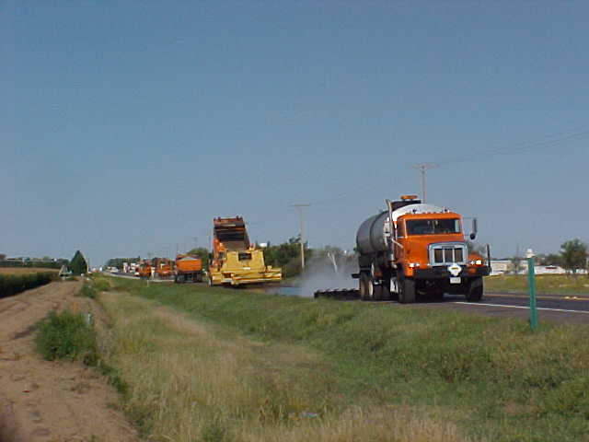
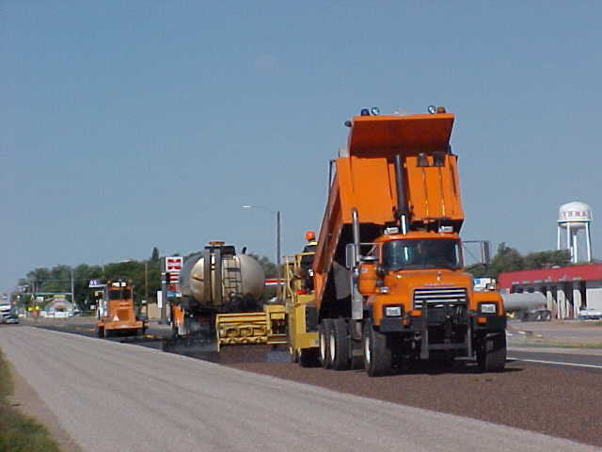
Preserving Your Chip Seal
Run a lite plow
Watch your speed
Roll your plow back
Run double blades and watch new cutting edges
Notes:
Remember that Surface Treatment is a huge investment and we need to protect it. Here a a few tactics to employ when plowing on chip seals.
It is also important to remember that a lot of our activities in the winter time can affect our surface condition

