Slide 1
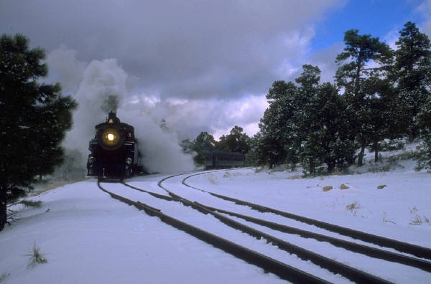
When Approaching Tracks with Plows
DO NOT PLOW OVER RAILROAD TRACKS
Lift plow components before the tracks
Verify plow components are lifted off of roadway
SLOWLY pass over the tracks
Lower components after clearing the tracks

